Slide 1


FootballStats - itucsdb1930 2019-20 Fall Database Systems Project
THE LEAGUE OF WORLD
Contributors:
Muhammed Enes Tırnakçı – 150160038
Beraat Buz – 150160002
Ahmet Yılmaz - 150160805

Slide 2
Objectives of FootballStats:
Keeping informations of players, managers, teams, referees, stadiums
Starting and controlling live matches
Showing statistics about played matches
Showing top assist and top goal players
**This system follows live football matches and keep some statistic about players, teams, matches, stadiums, referees, over the matches played before in England Premier League.

Slide 3
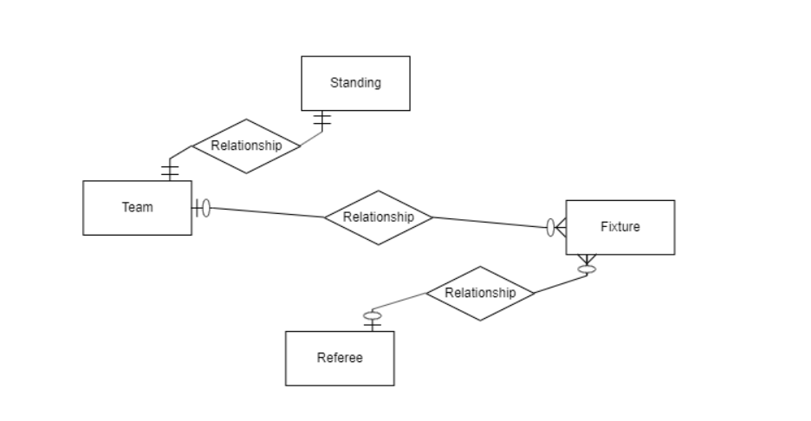
Beraat Buz
- Standing, fixture, and referee tables

Slide 4
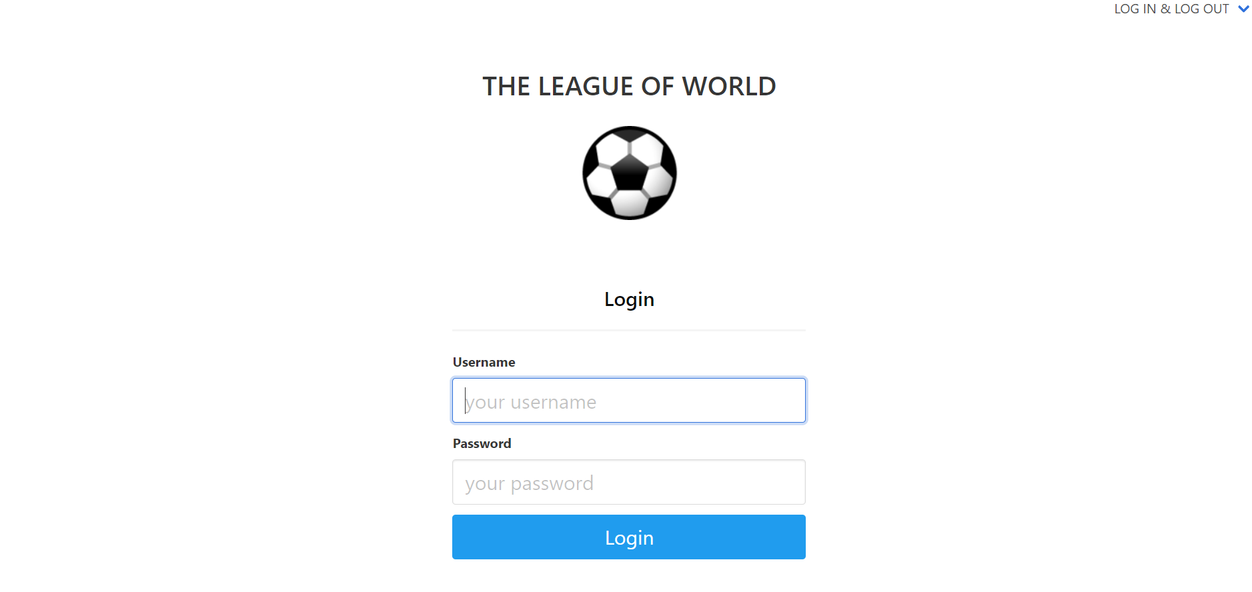
The administrator can login to operate CRUD operations

Slide 5
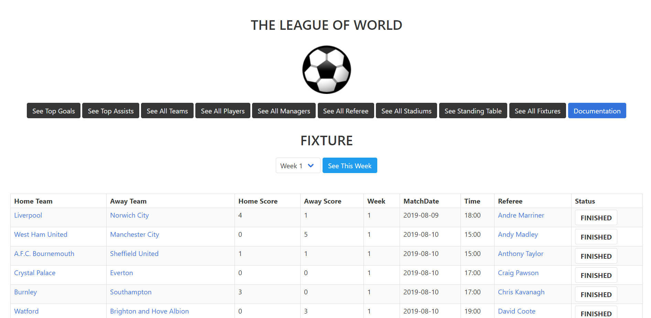
The user can see all fixtures up to week 4, and control the status of matches. Moreover, the user can reach more information about the match using status buttons.

Slide 6
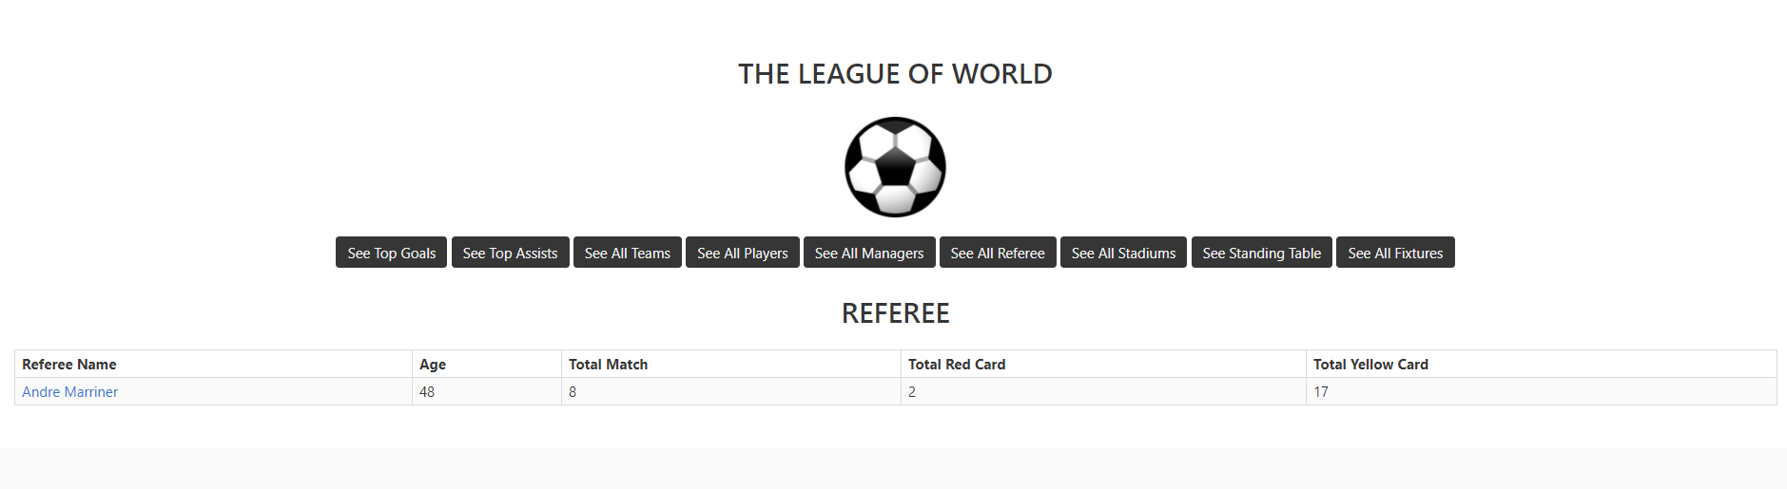
The user can see some information about the referee by clicking referee name at fixture page.

Slide 7
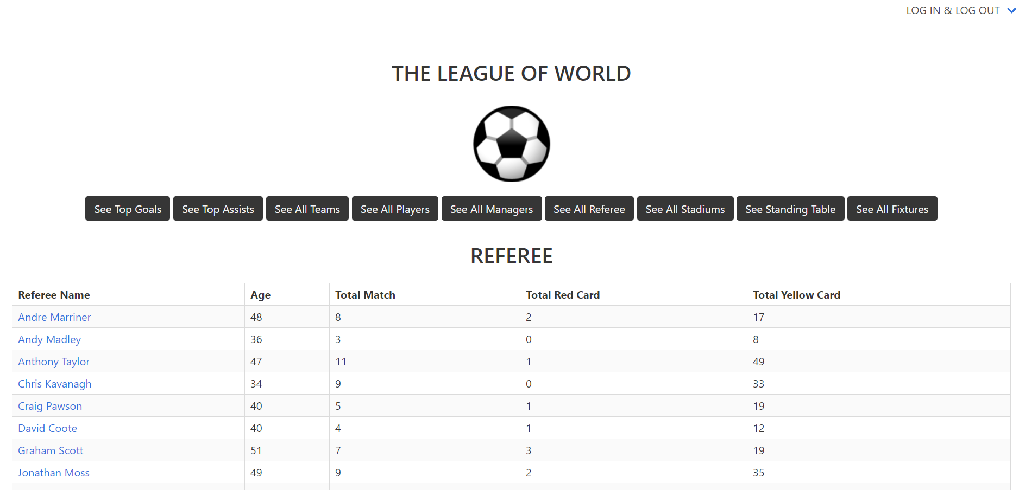
The user can see some information about all referees.

Slide 8
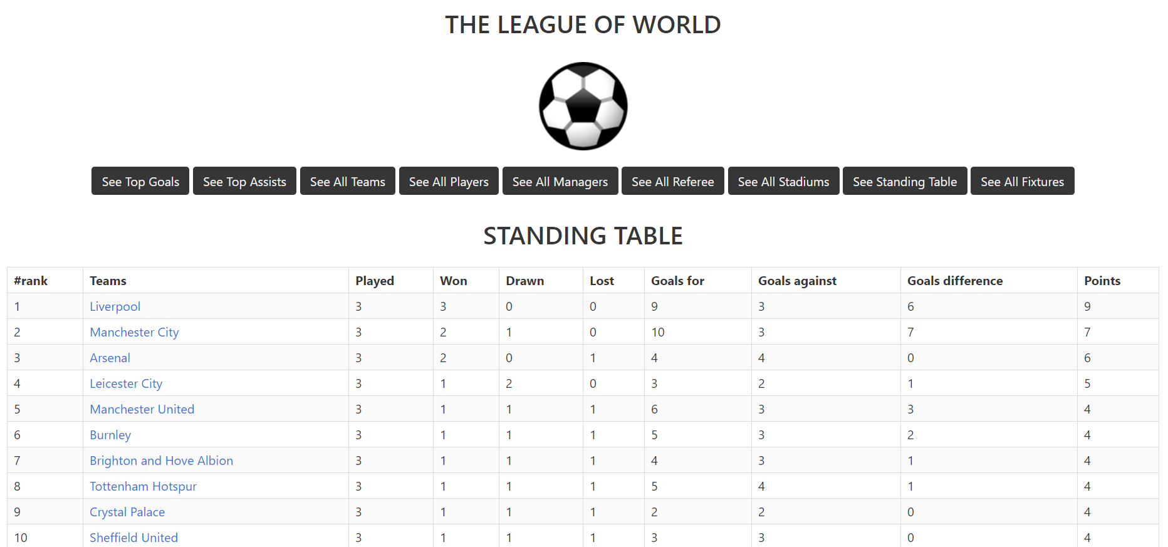
The user can see standing table in the EPL.

Slide 9
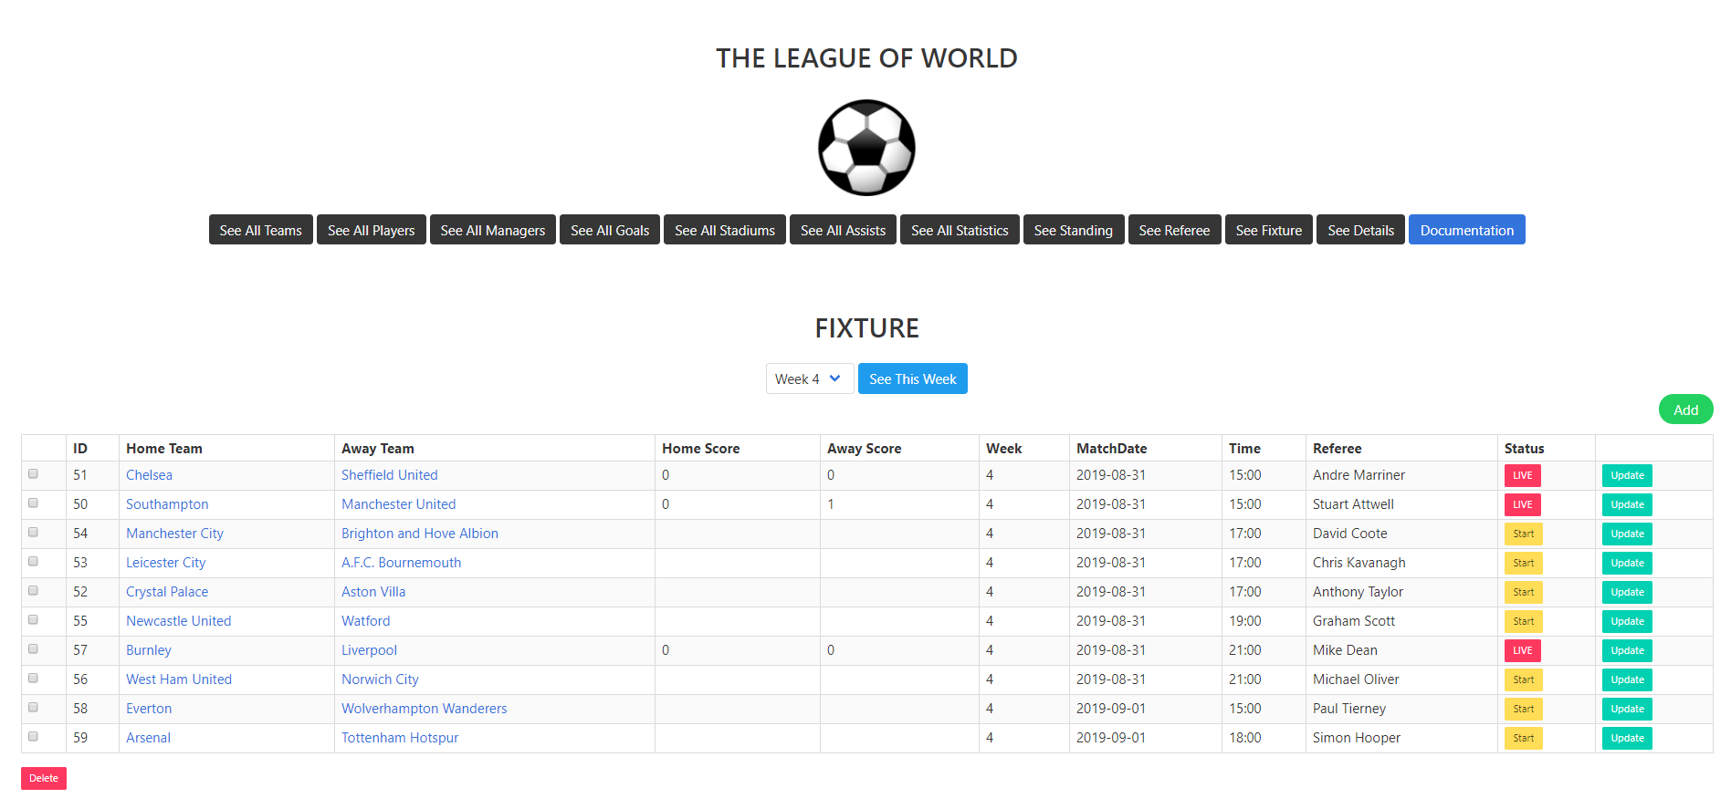
After login, in the beginnig the page in which add, update, delete and starting the match operations about fixture can be done seen. The administrator can do these operations. Delete operation is operated by using checkboxes.

Slide 10
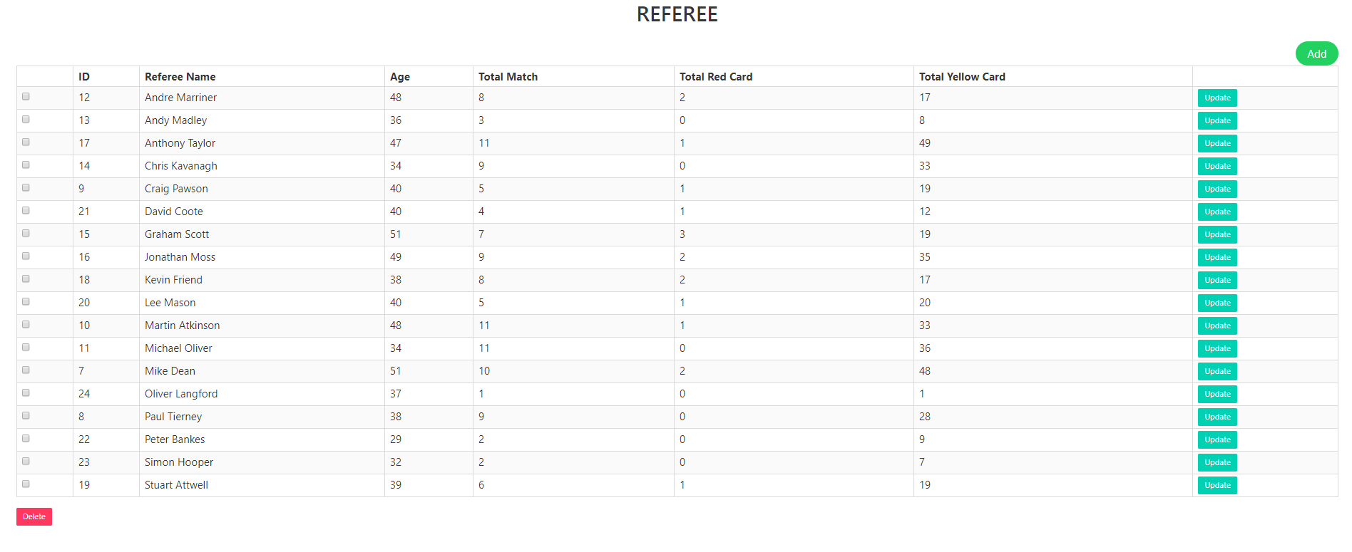
After login, by clicking see all referee the page in which add, update and delete operations about referees can be done seen. The administrator can do these operations. Delete operation is operated by using checkboxes

Slide 11
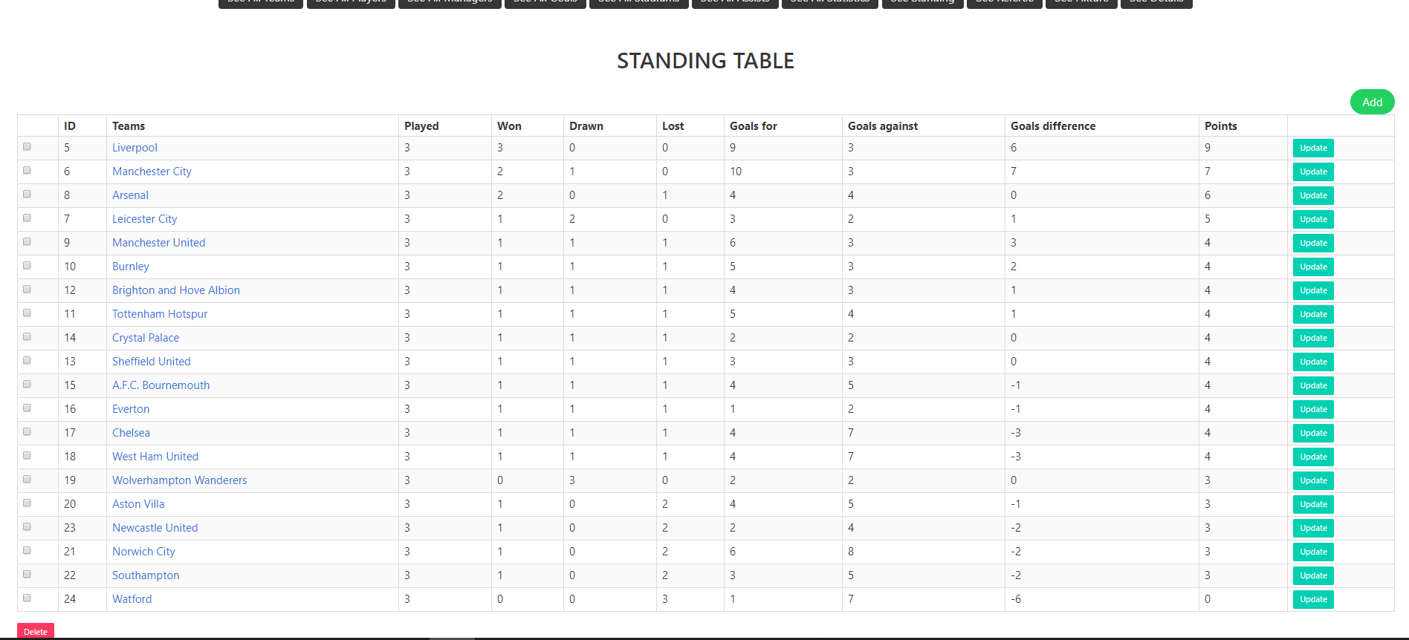
After login, by clicking see standing table the page in which add, update and delete operations about standing table can be done seen. The administrator can do these operations. Delete operation is operated by using checkboxes

Slide 12
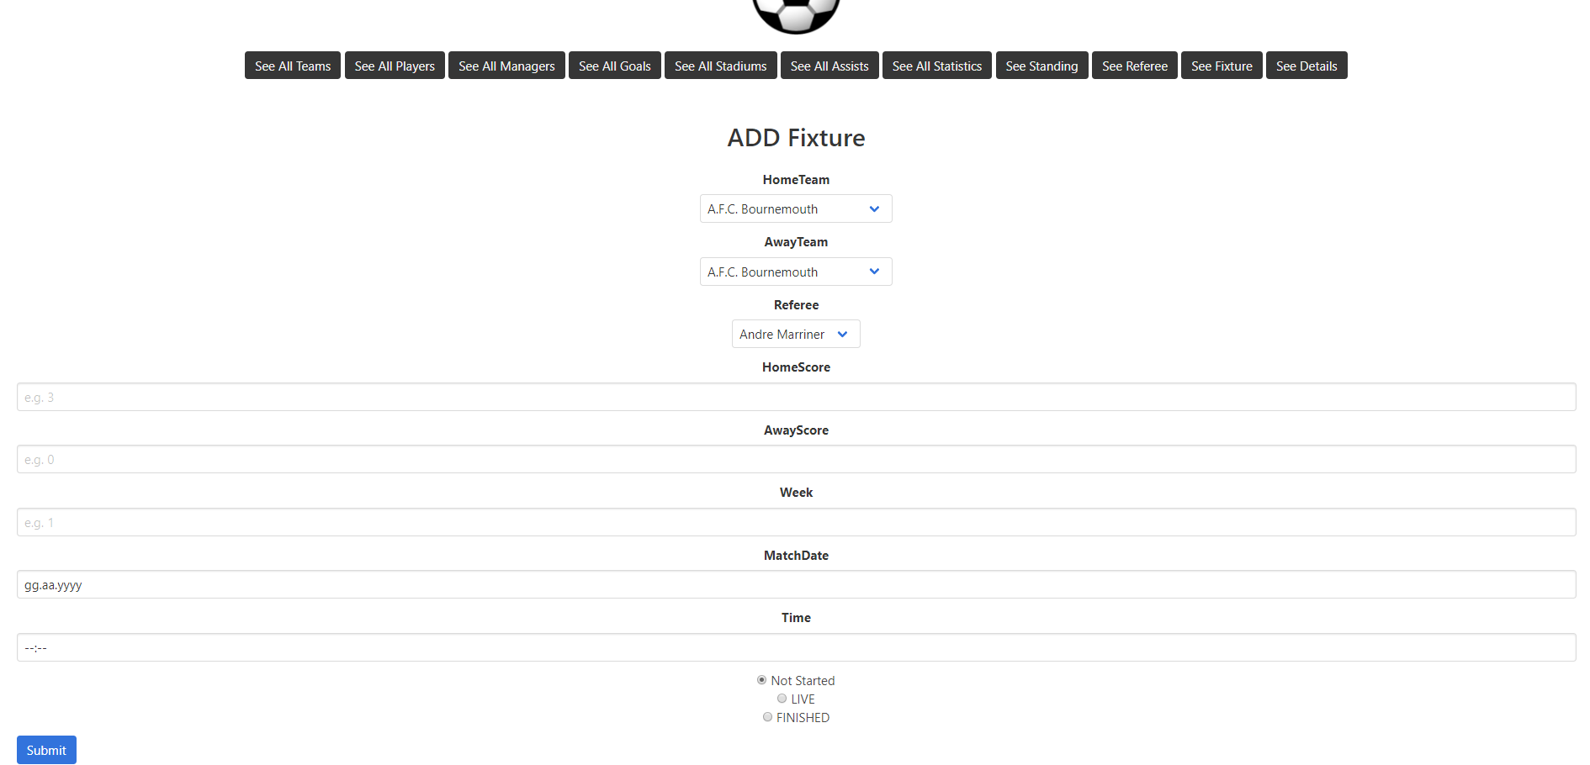
The administrator can add more fixtures in this page.

Slide 13
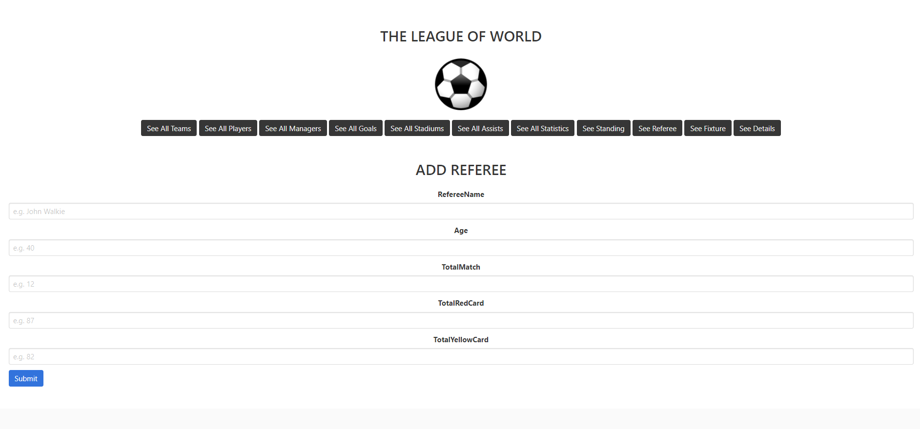
The administrator can add more referees in this page.

Slide 14
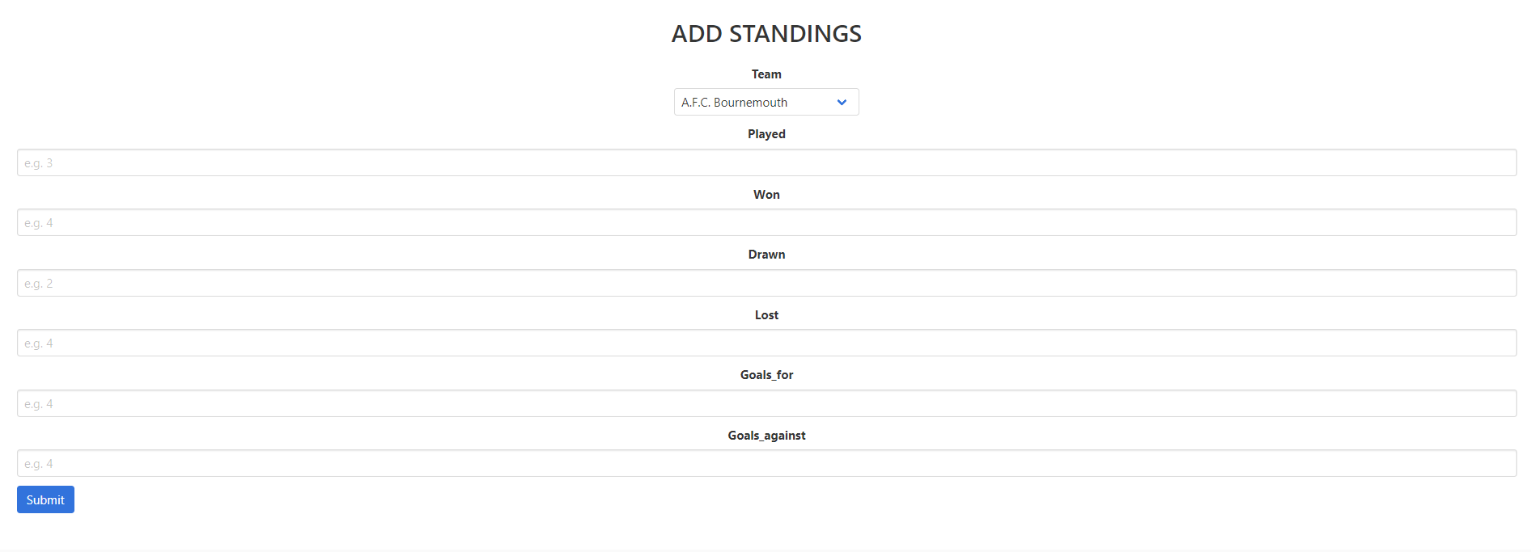
The administrator can add more teams to standing table in this page.

Slide 15
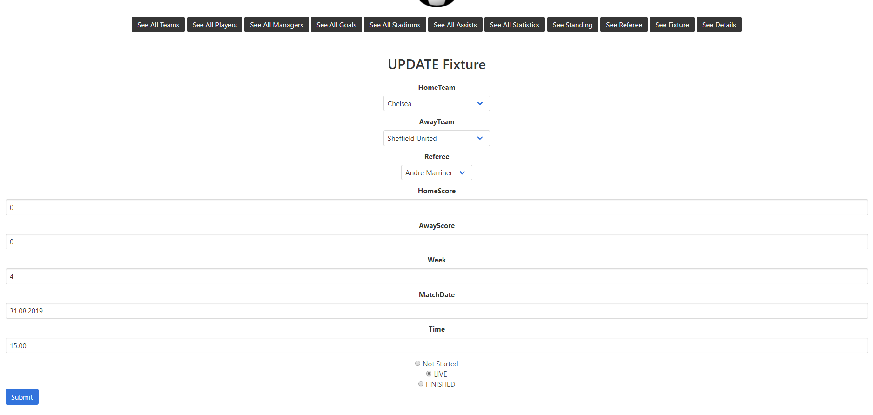
The administrator can update the fixture which is selected in this page.

Slide 16
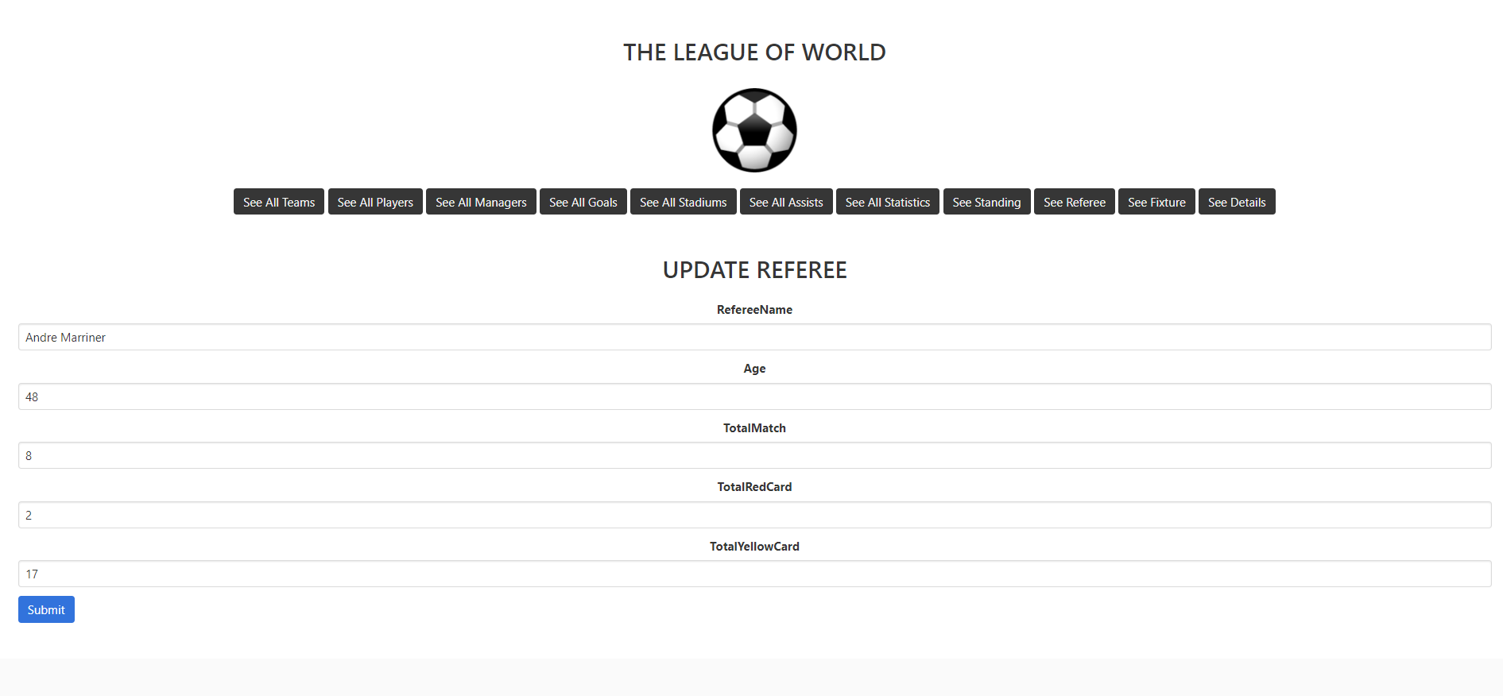
The administrator can update the fixture which is selected in this page.

Slide 17
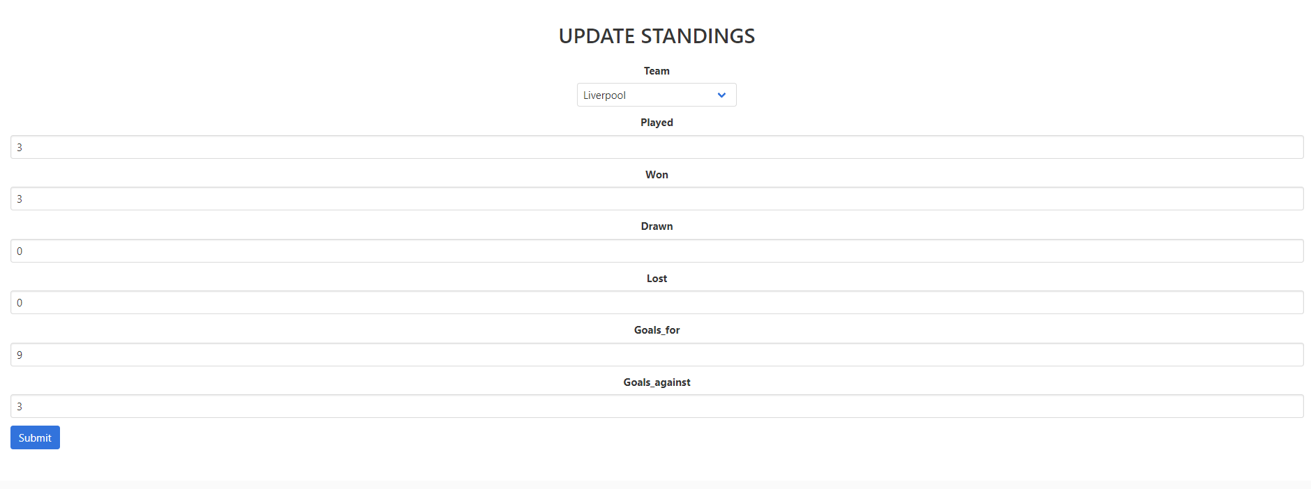
The administrator can update the team’s status in the standing table which is selected in this page.

Slide 18
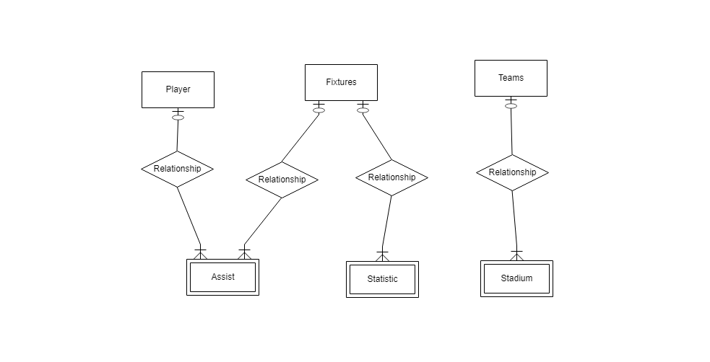
Ahmet Yılmaz
Asisst, Statistic, Stadium, and MatchDetails tables

Slide 19
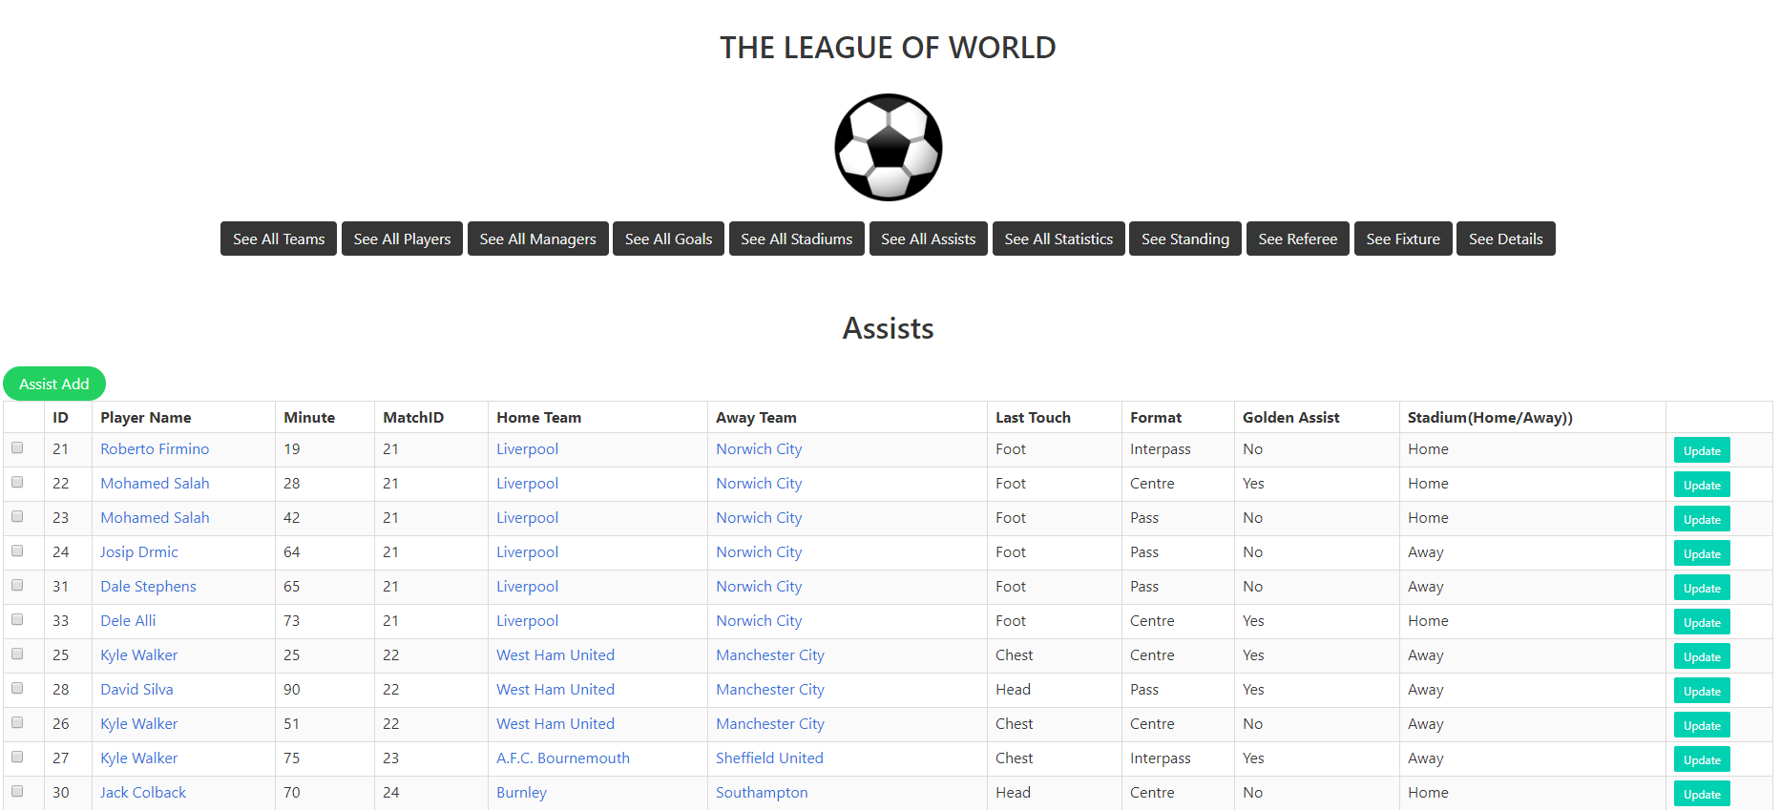
After login the website, the developer guy can see the assists for all match by clicking ‘See All Assists’ button. The developer also can add, update and delete the assists by clicking the buttons.

Slide 20
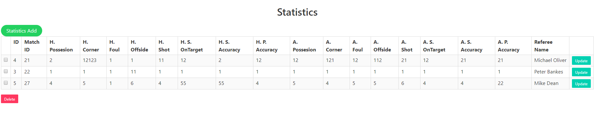
After login the website, the developer guy can see the statistic for all match by clicking ‘See All Statistics’ button. The developer also can add, update and delete the statistic by clicking the buttons.

Slide 21
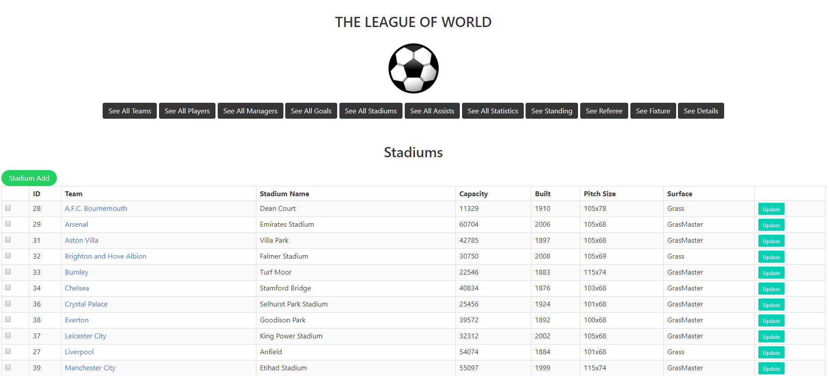
After login the website, the developer guy can see the stadiums for all teams by clicking ‘See All Stadiums’ button. The developer also can add, update and delete the by clicking the buttons.

Slide 22
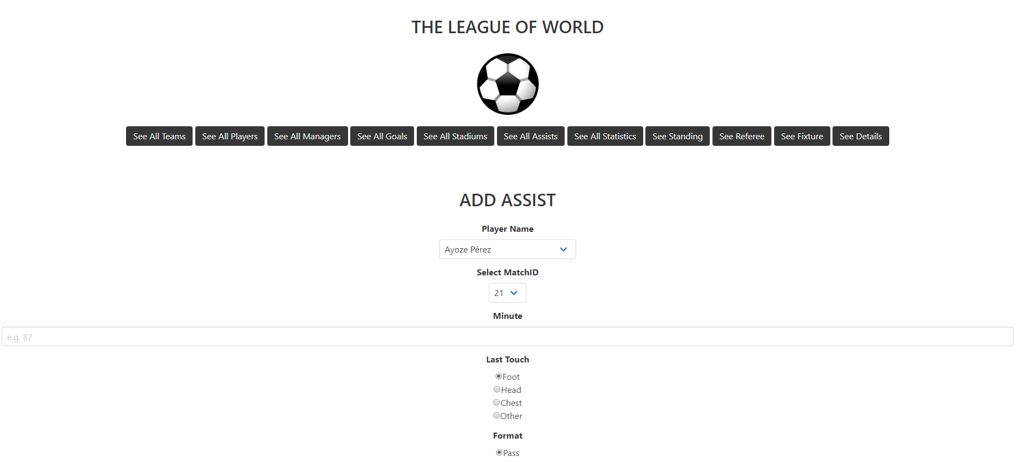
Assist addding page for developer.

Slide 23
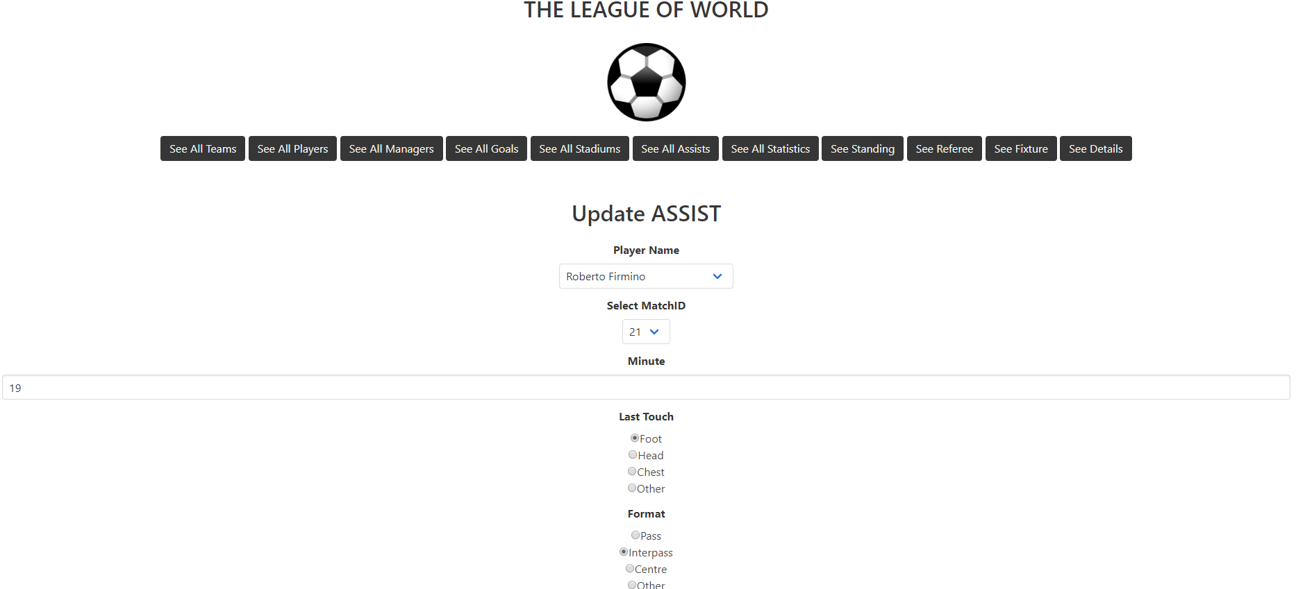
To update an assist data, developer can use the this page after click update button.

Slide 24
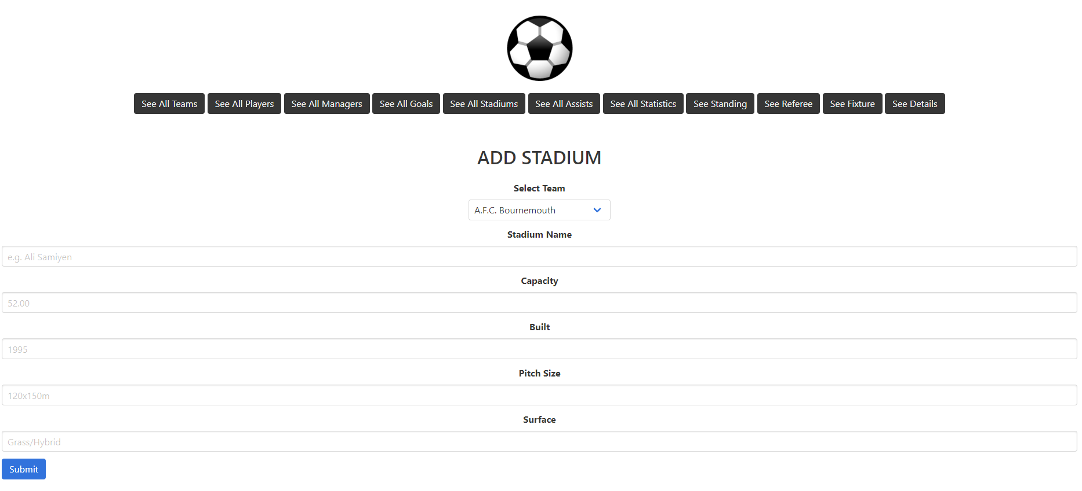
Stadium addding page for developer.

Slide 25
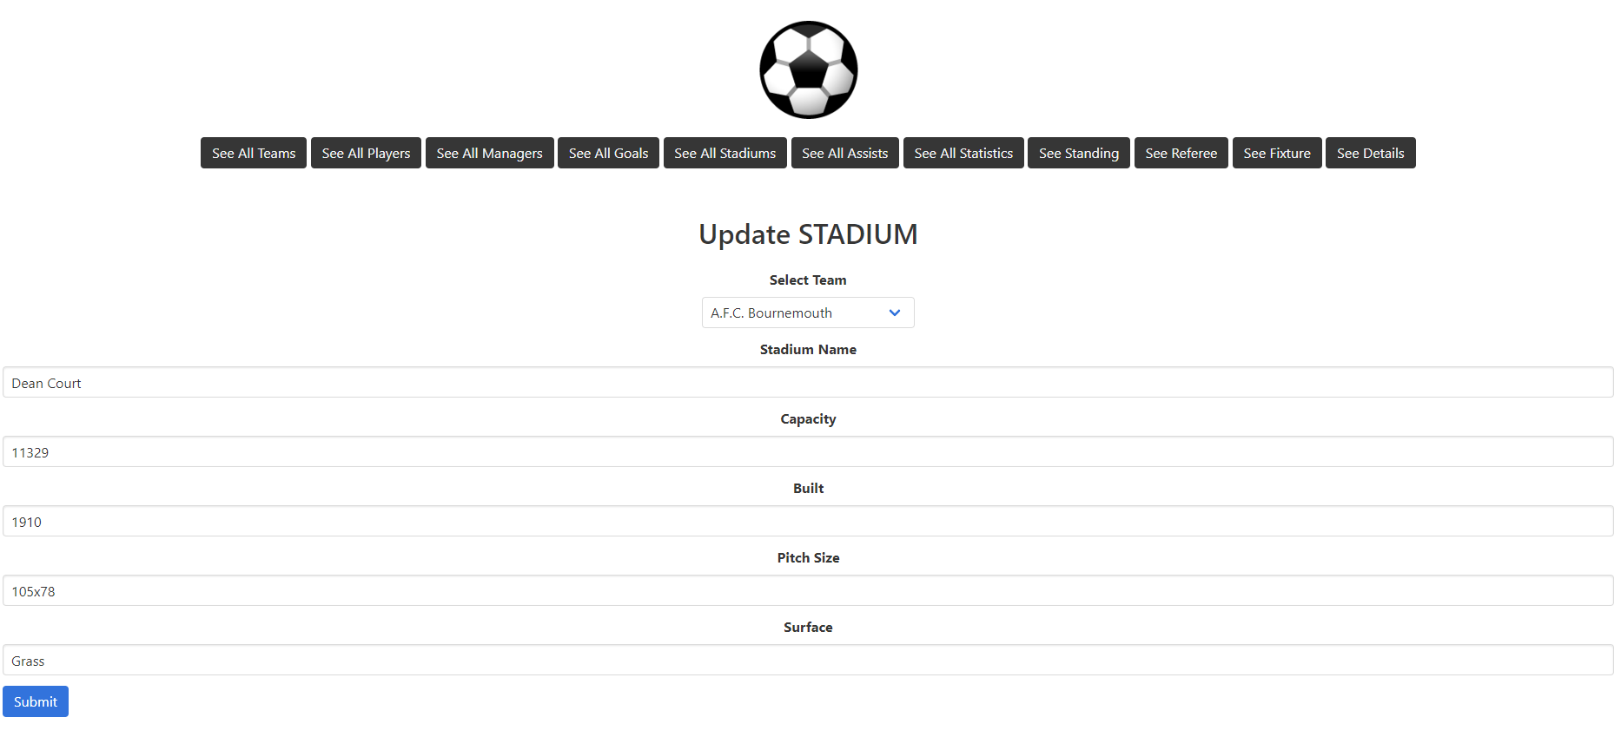
To update a stadium data, developer can use the this page after click update button.

Slide 26
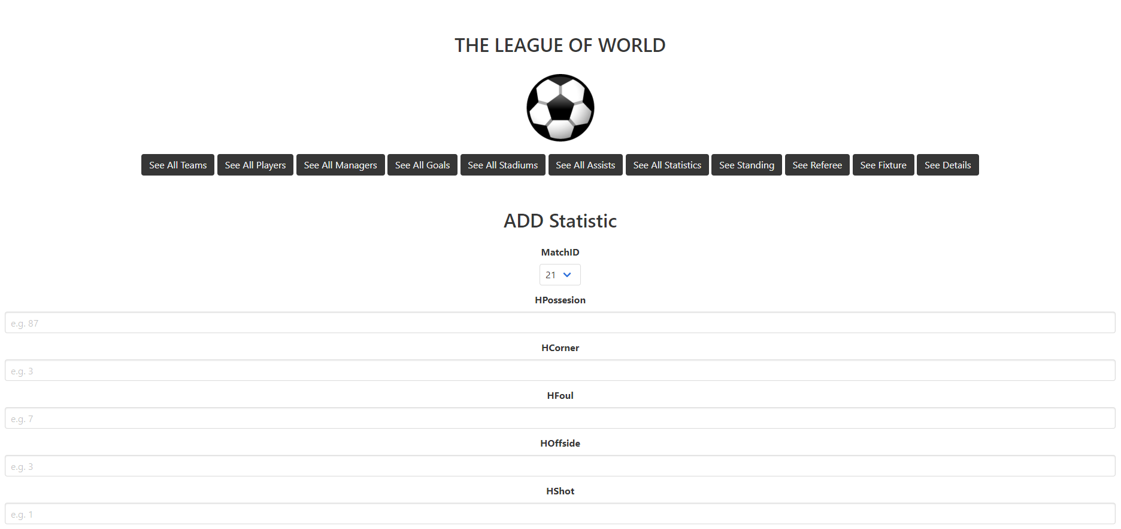
Statistic adding page for developer.

Slide 27
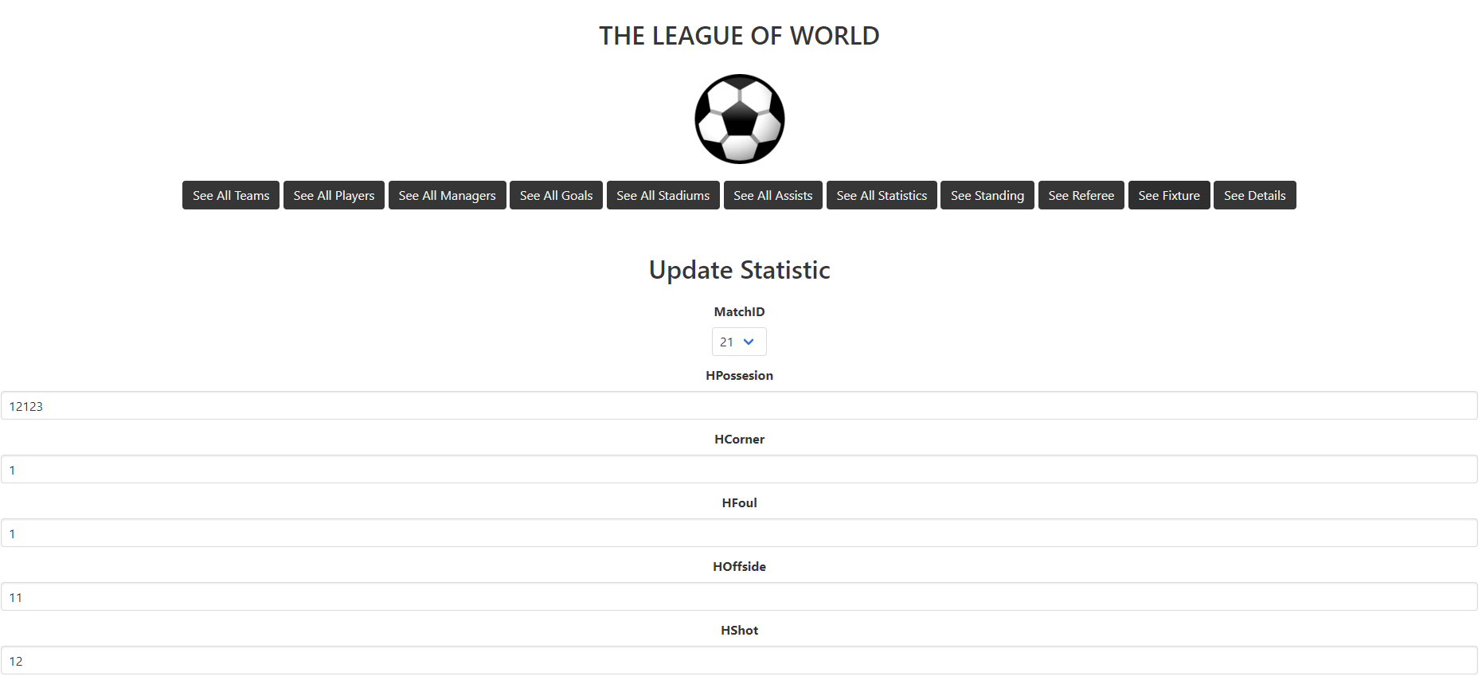
To update a statistic data, developer can use the this page.

Slide 28
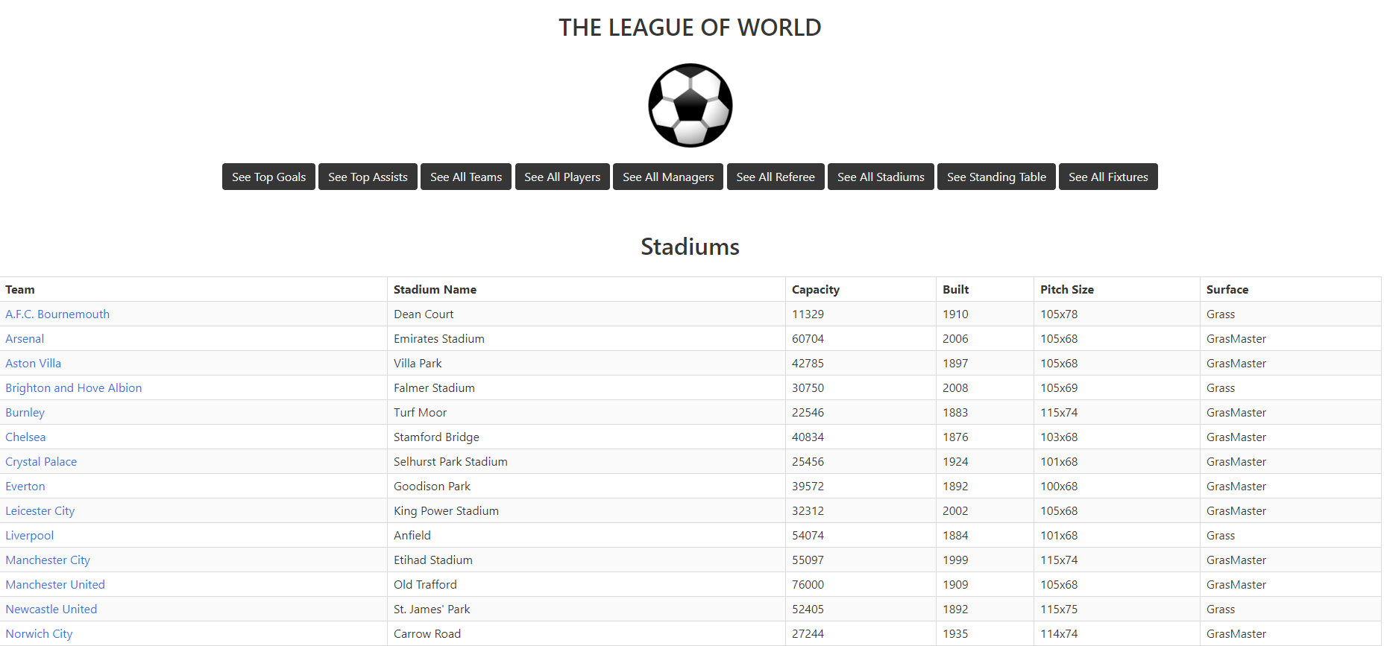
The user can see all stadium of teams by clicking the ‘See All Stadiums’ button.

Slide 29
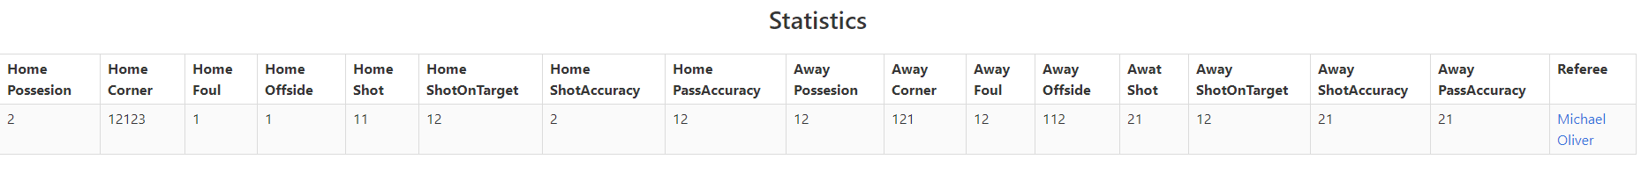
The user can see statistic of a match by clicking match details on the fixture page.

Slide 30
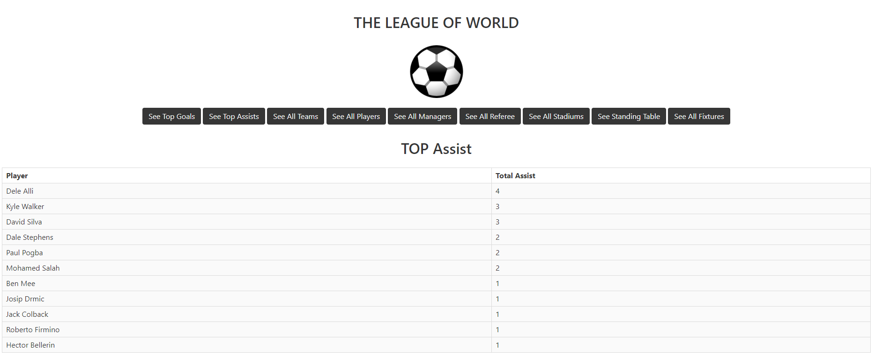
The user can see top assist player in this page by clicking the ‘See Top Assists’ button.

Slide 31
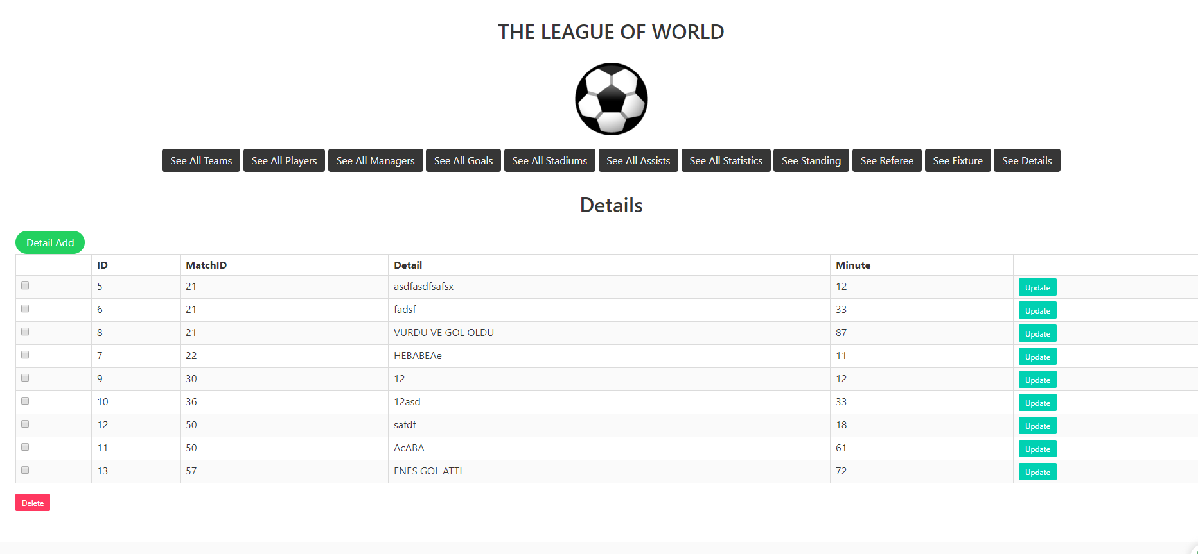
After login the website, the developer guy can see the details for all teams by clicking ‘See All Details’ button. The developer also can add, update and delete the by clicking the buttons.

Slide 32
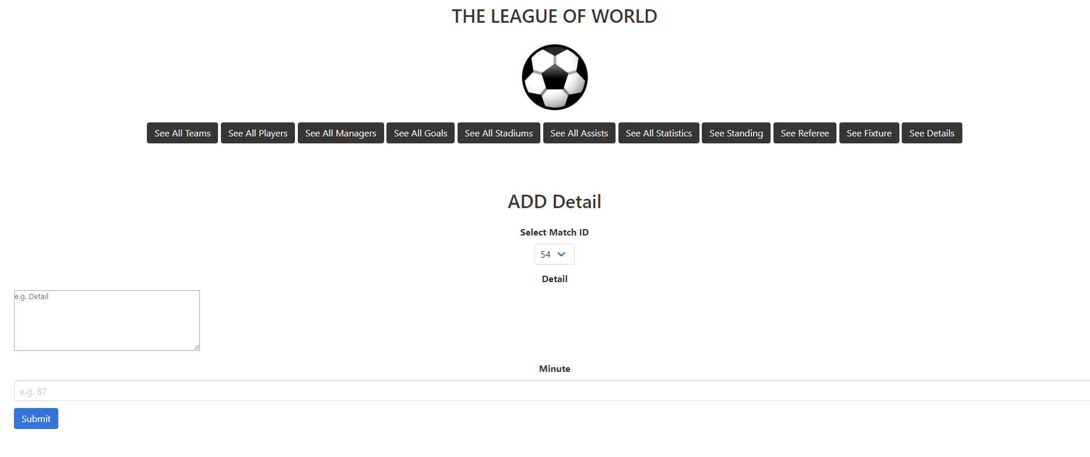
Stadium adding page for developer.

Slide 33
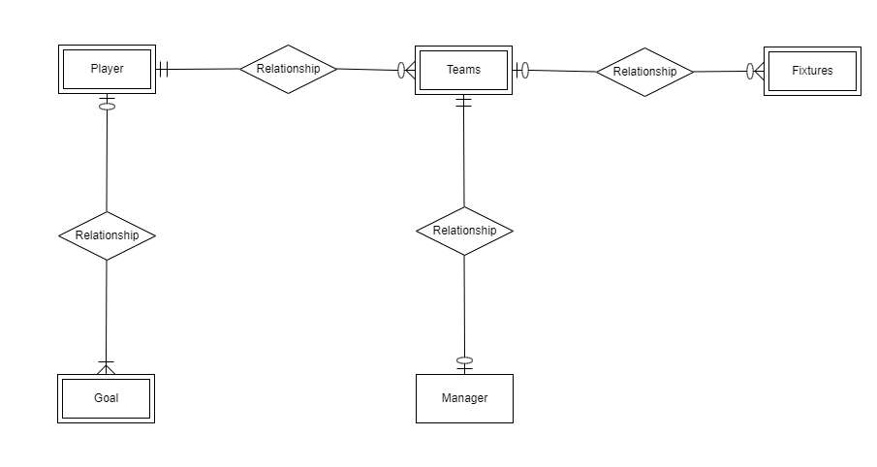
Muhammed Enes Tırnakçı
- Teams, player, manager, and goal tables

Slide 34
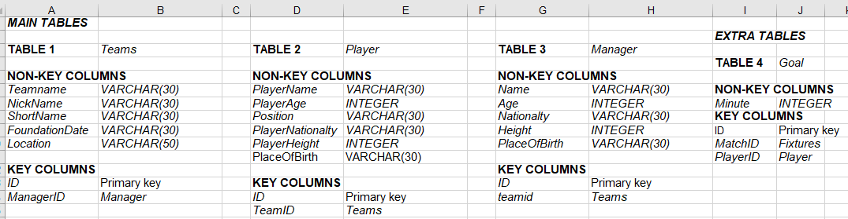
TABLES

Slide 35
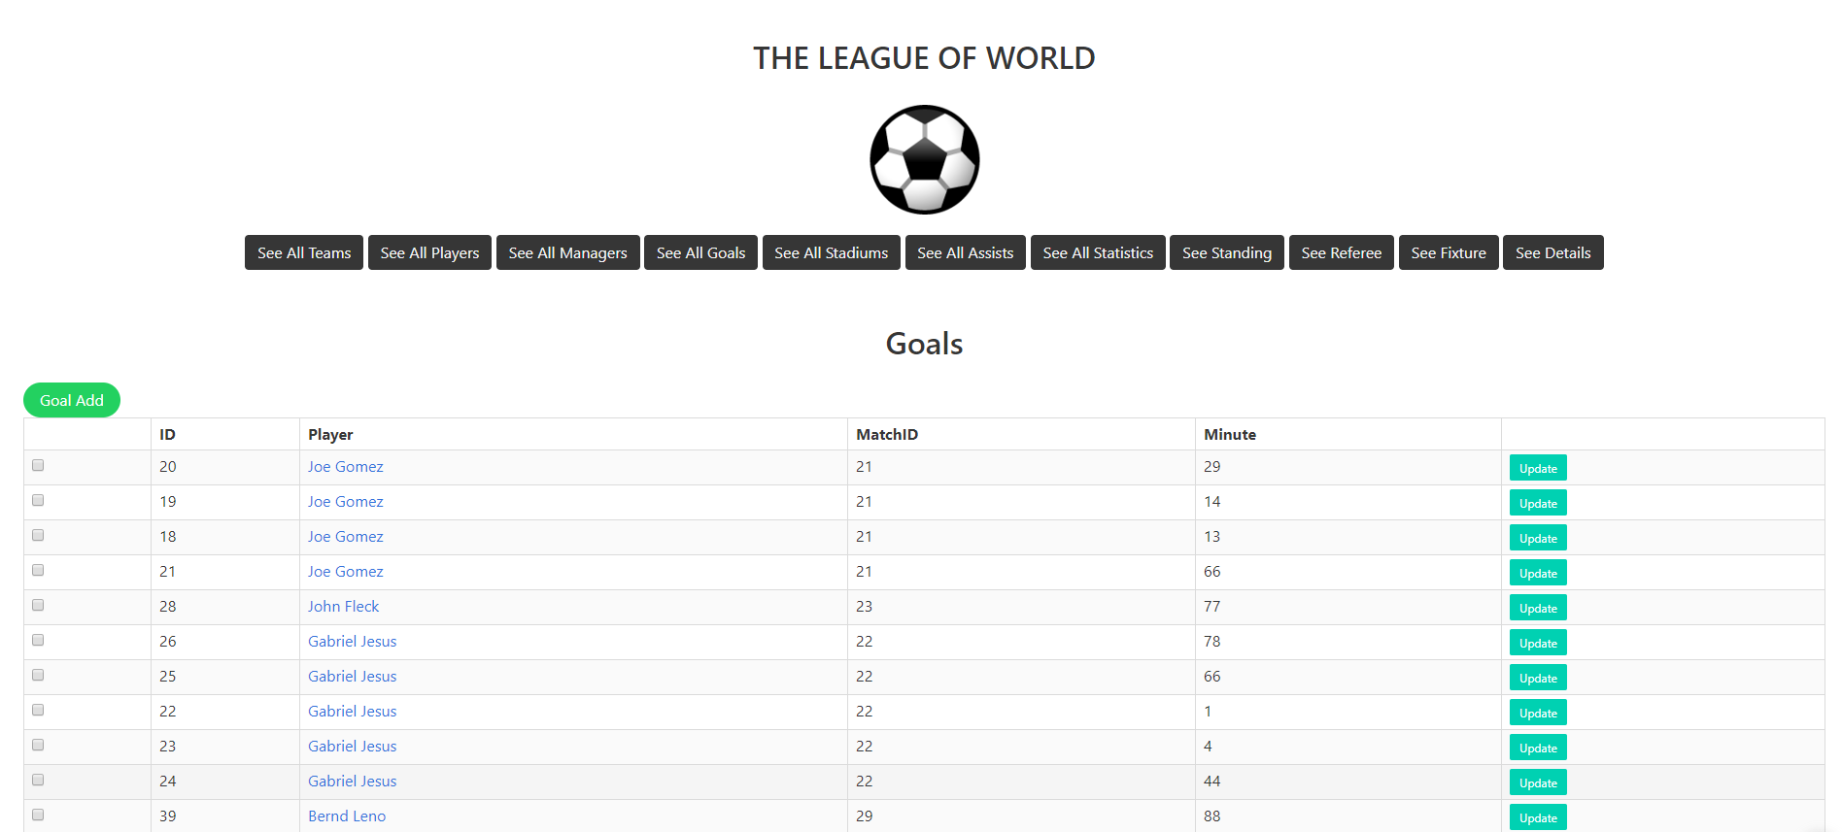
After logging in, the developer can see all goals in this page by clicking the ‘See All Goals’ button. Developer can delete and update the goals.

Slide 36
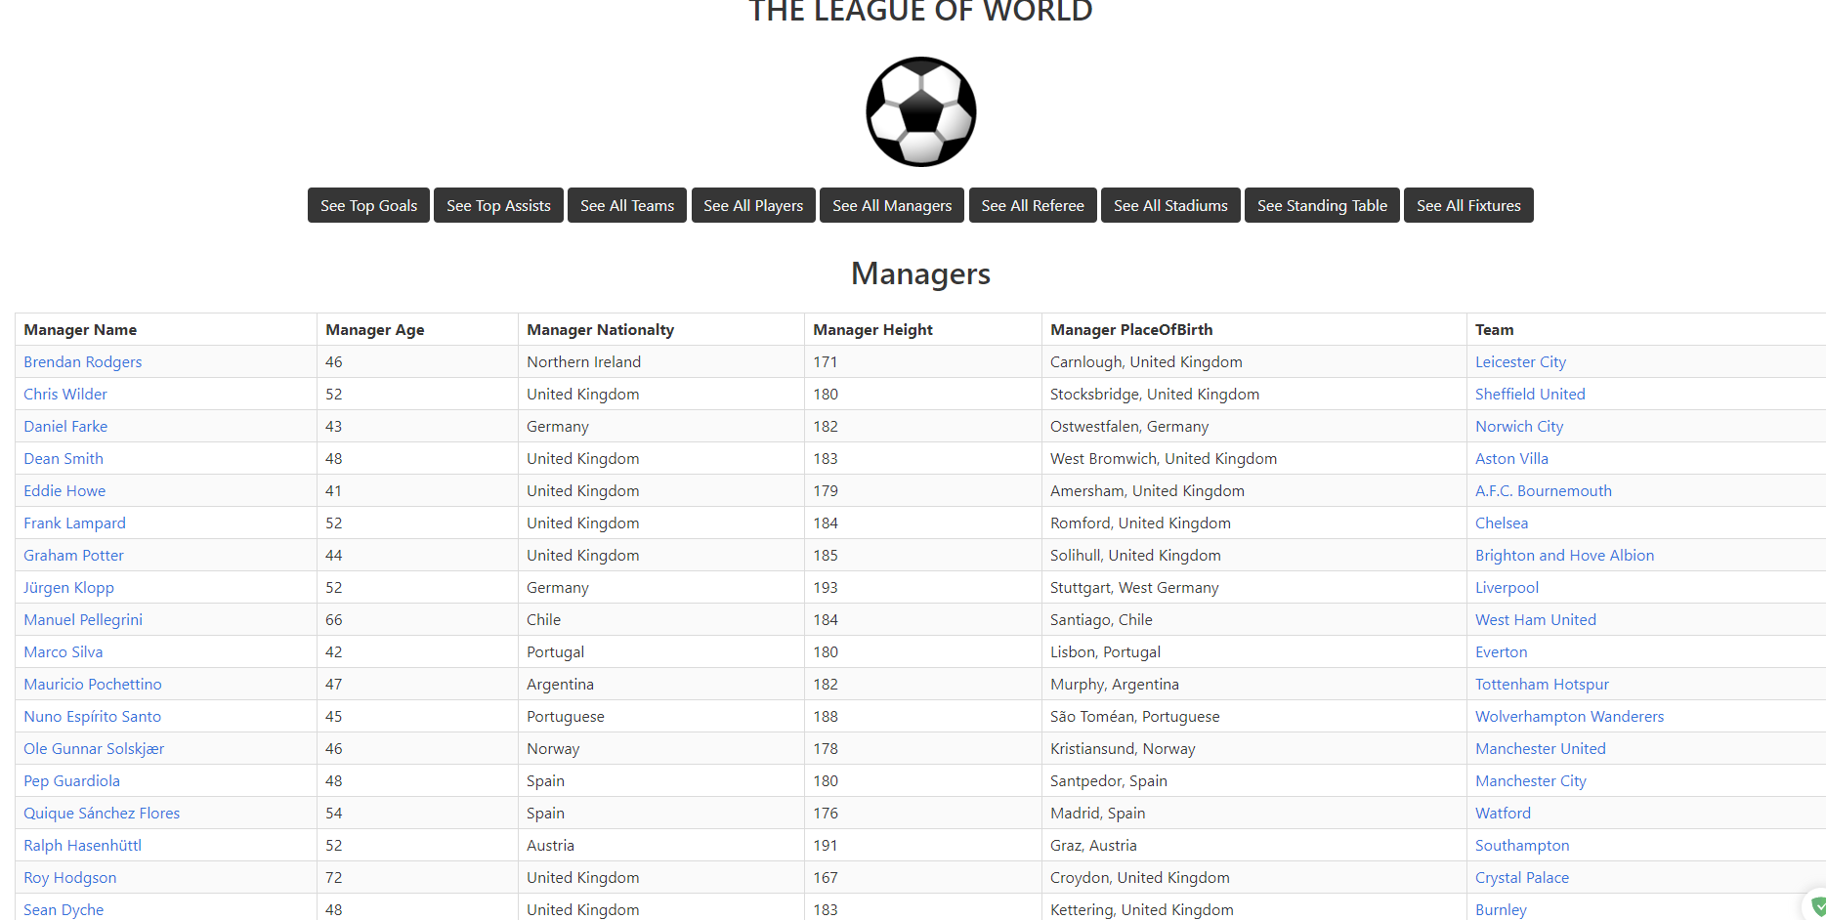
The user can see all managers in this page by clicking the ‘See All Managers’ button.

Slide 37
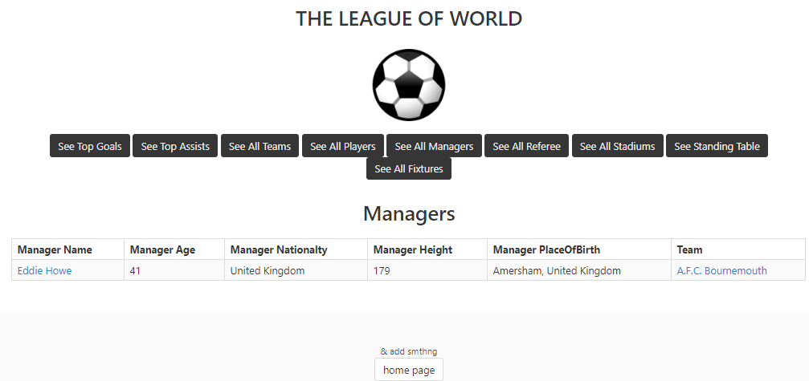
Key access for managers table in user mode. Clicking name of the manager in list of
manager page or in the teams page will redirect to this page.

Slide 38
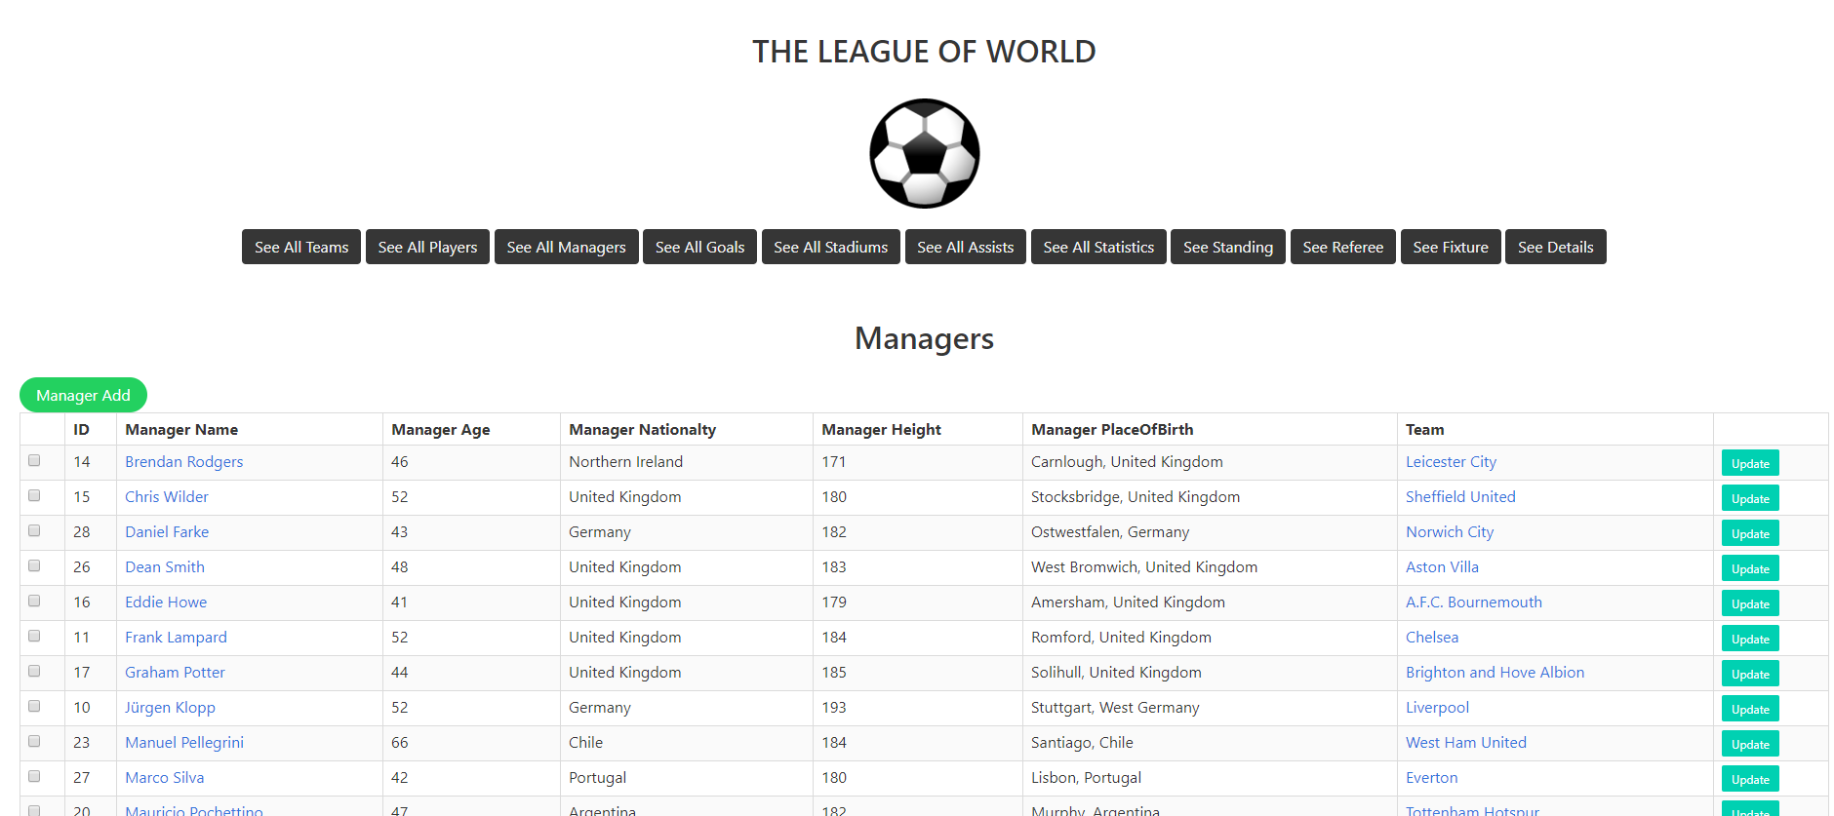
After logging in, the developer can see all managers in this page by clicking the ‘See All Managers’ button. Developer can delete and update the managers.

Slide 39
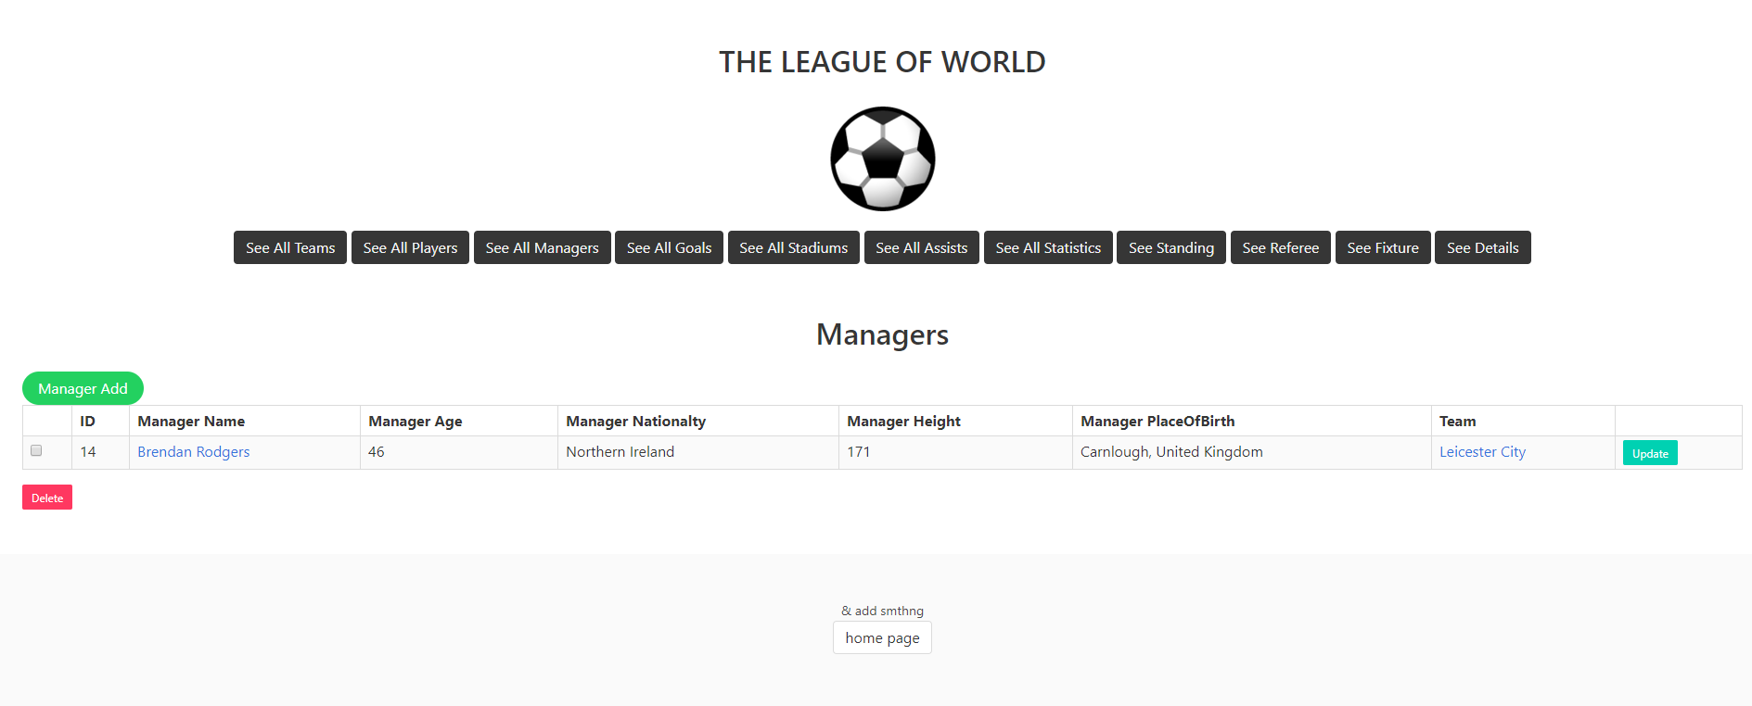
Key access for managers table in developer mode.

Slide 40
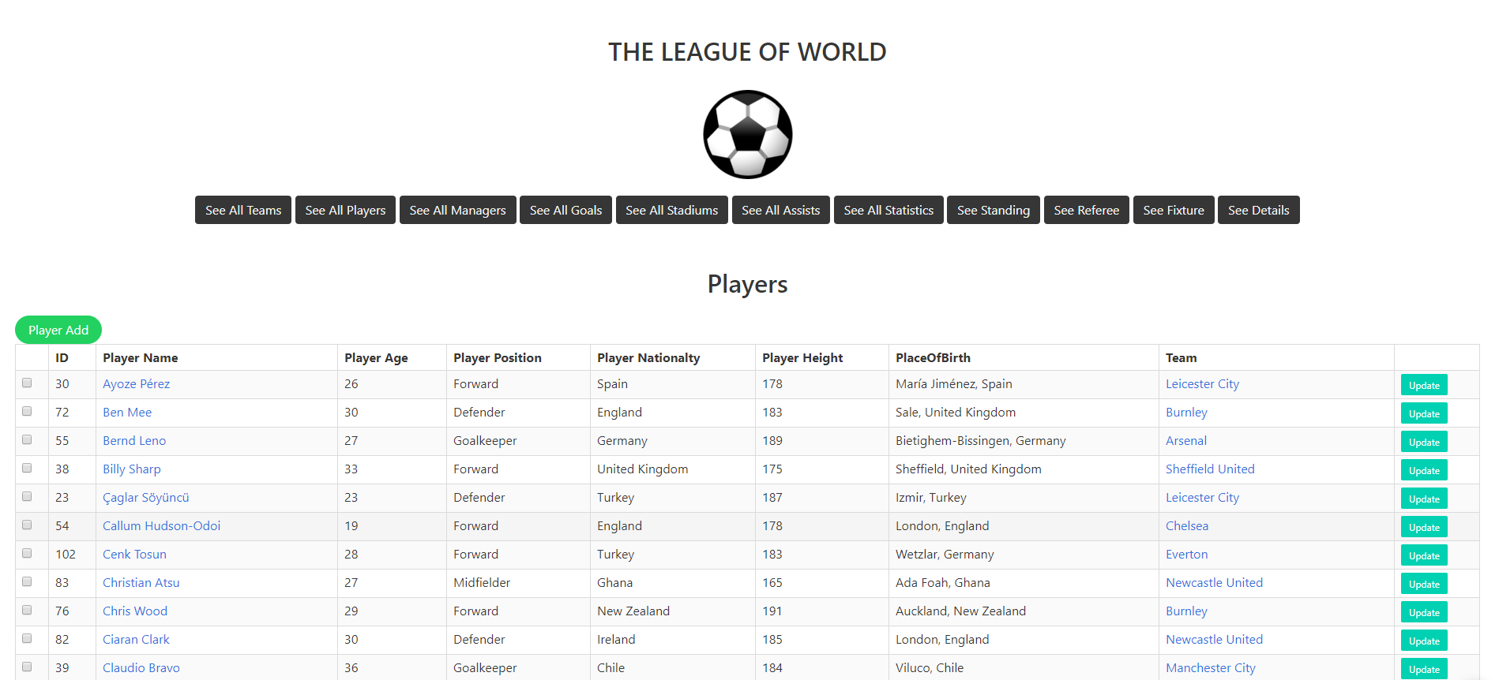
After logging in, the developer can see all players in this page by clicking the ‘See All Players button. Developer can delete and update the players.

Slide 41

Key access for player table in developer mode. By clicking to the name of the player will redict to the this page.

Slide 42
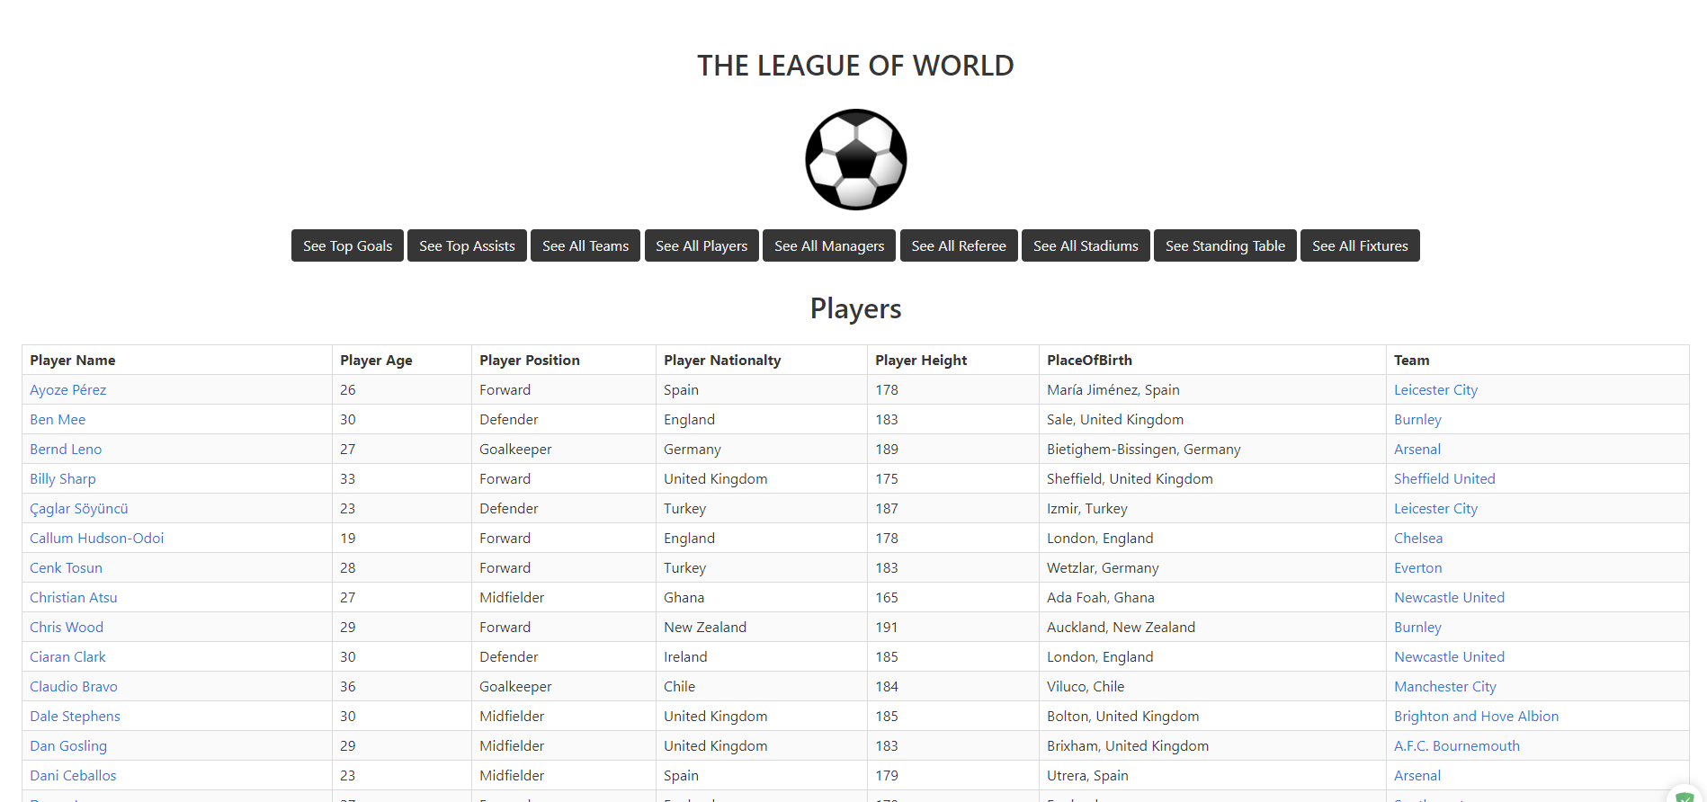
The user can see all players in this page by clicking the ‘See All Players’ button.

Slide 43
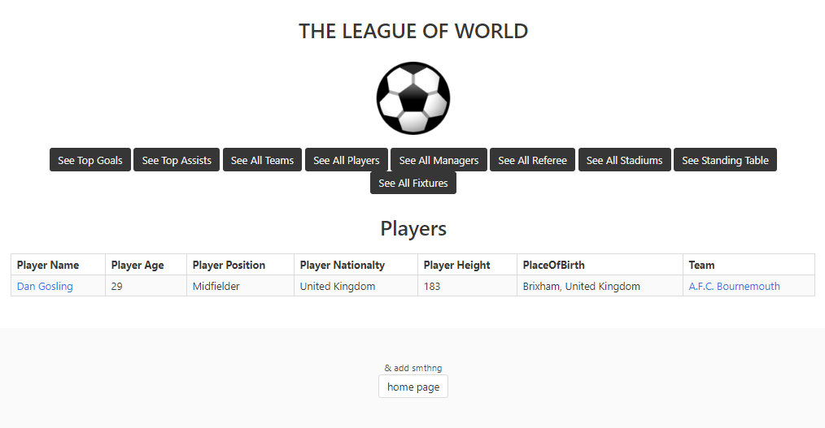
Key access for players table in user mode. By clicking to the name of the player will redict to this page

Slide 44
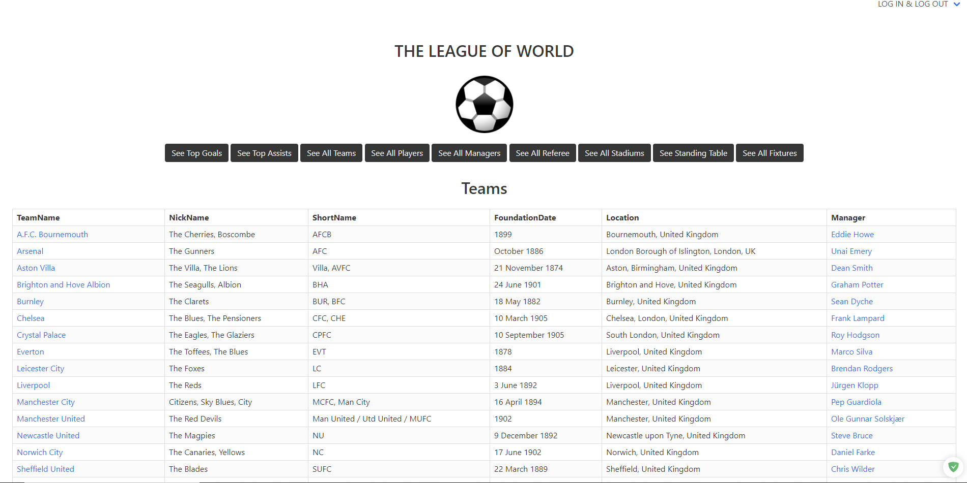
The user can see all teams in this page by clicking the ‘See All Teams’ button.

Slide 45
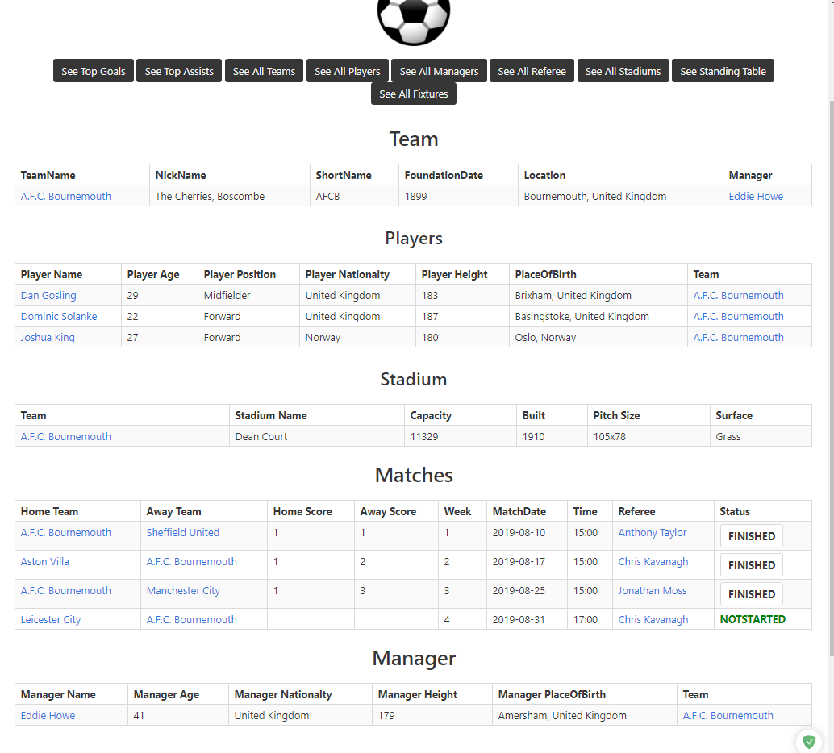
Key access for teams table in user mode.
By clicking name of the team will redirect to this page.
In this page all team players, stadium of the team, played or unplayed matches and manager of the team will be shown in this page.

Slide 46
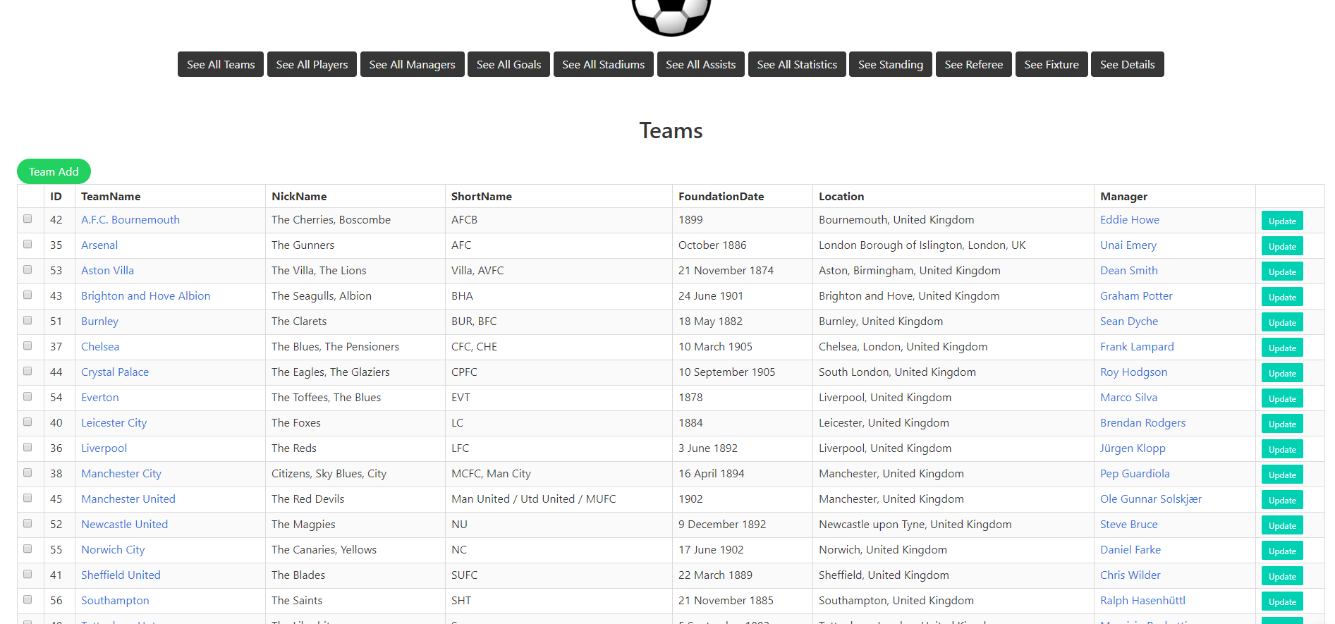
After logging in, the developer can see all teams in this page by clicking the ‘See All Teams’ button. Developer can delete and update the teams.

Slide 47
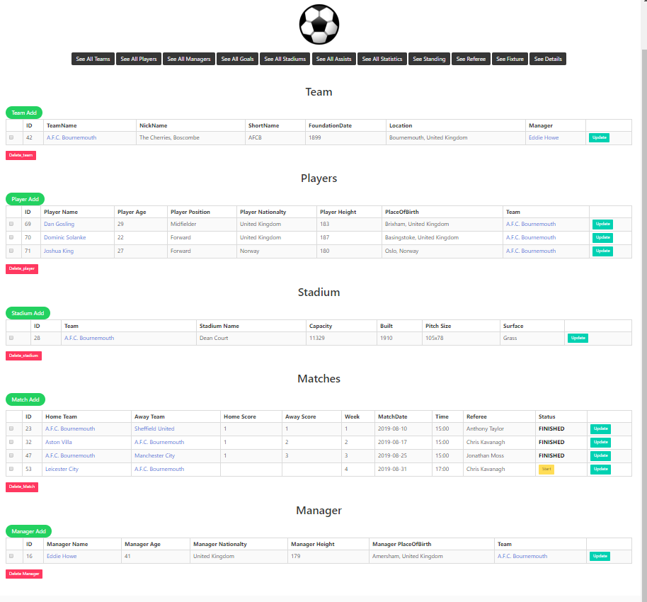
Key access for teams table in developer mode.
After loggining in, by clicking name of the team will redirect to this page.
In this page all team players, stadium of the team, played or unplayed matches and manager of the team will be shown in this page.
All buttons works properly.

Slide 48
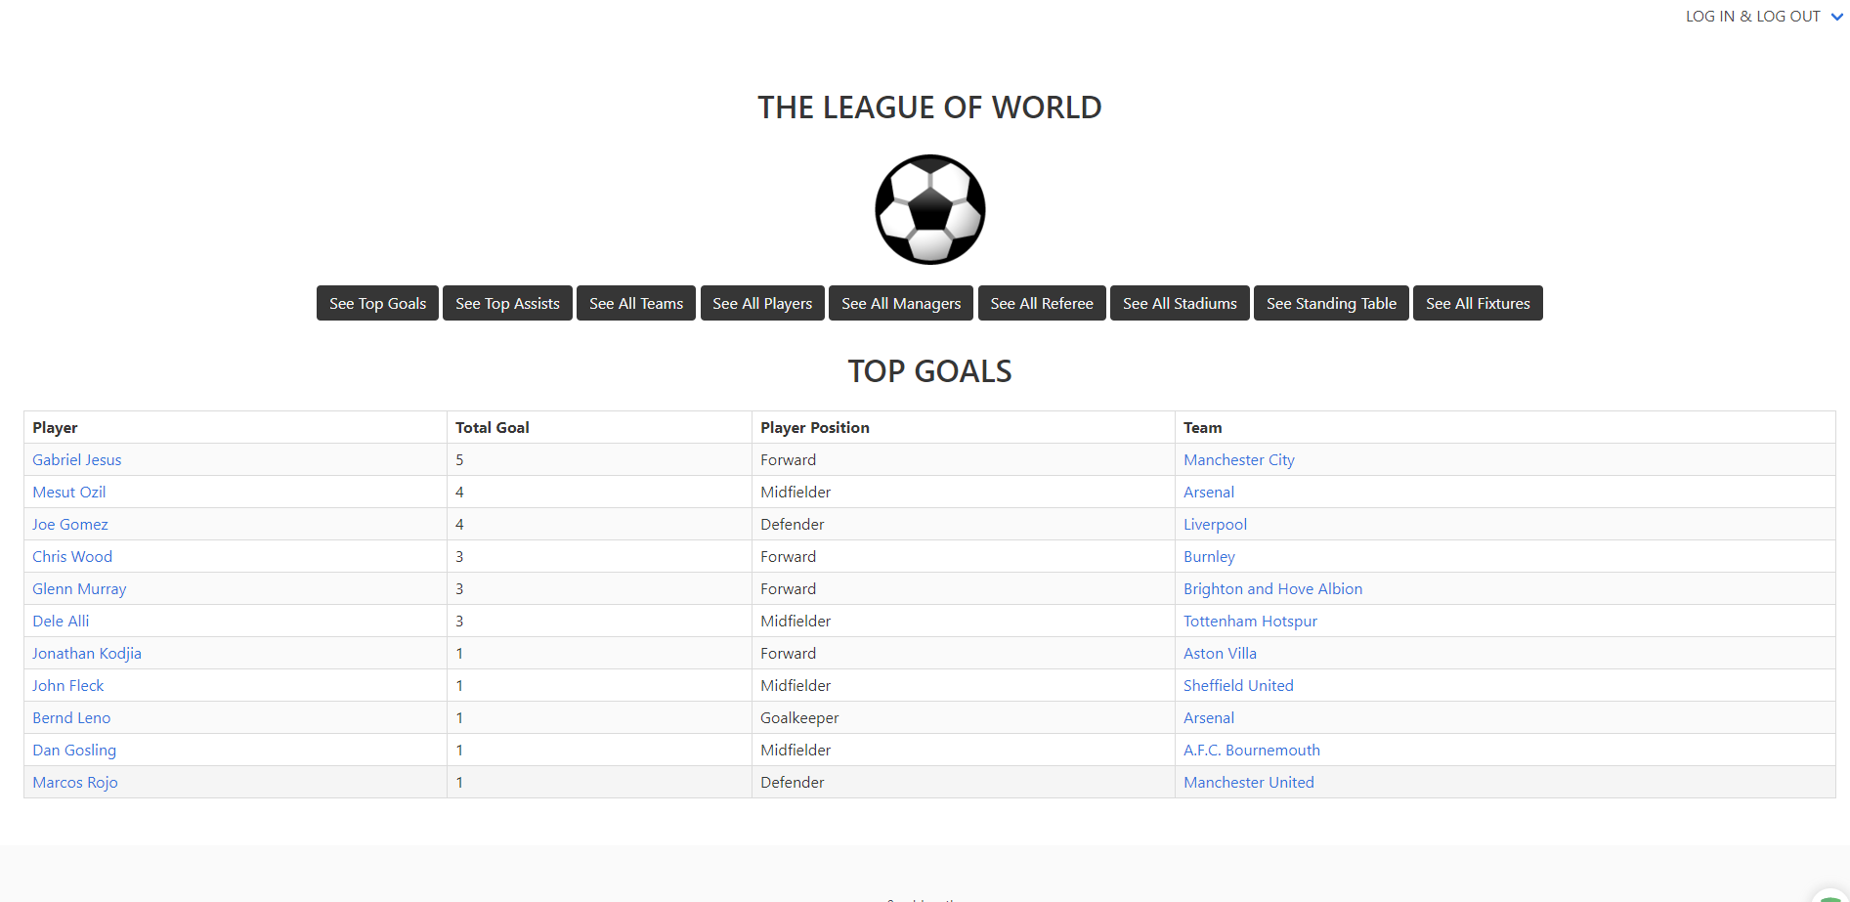
The user can see top goal player in this page by clicking the ‘See Top Goal’ button.

Slide 49
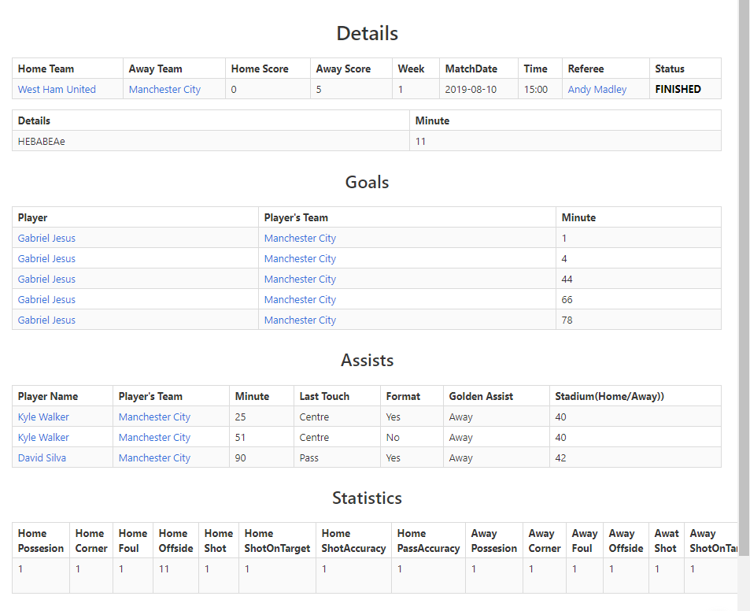
The user can see detailed match information in this page by clicking the ‘Finished or Live buttons in the fixture page.
If any new information is updated by developer in the live match page, and if the user refresh this page, user can see new informations.

Slide 50
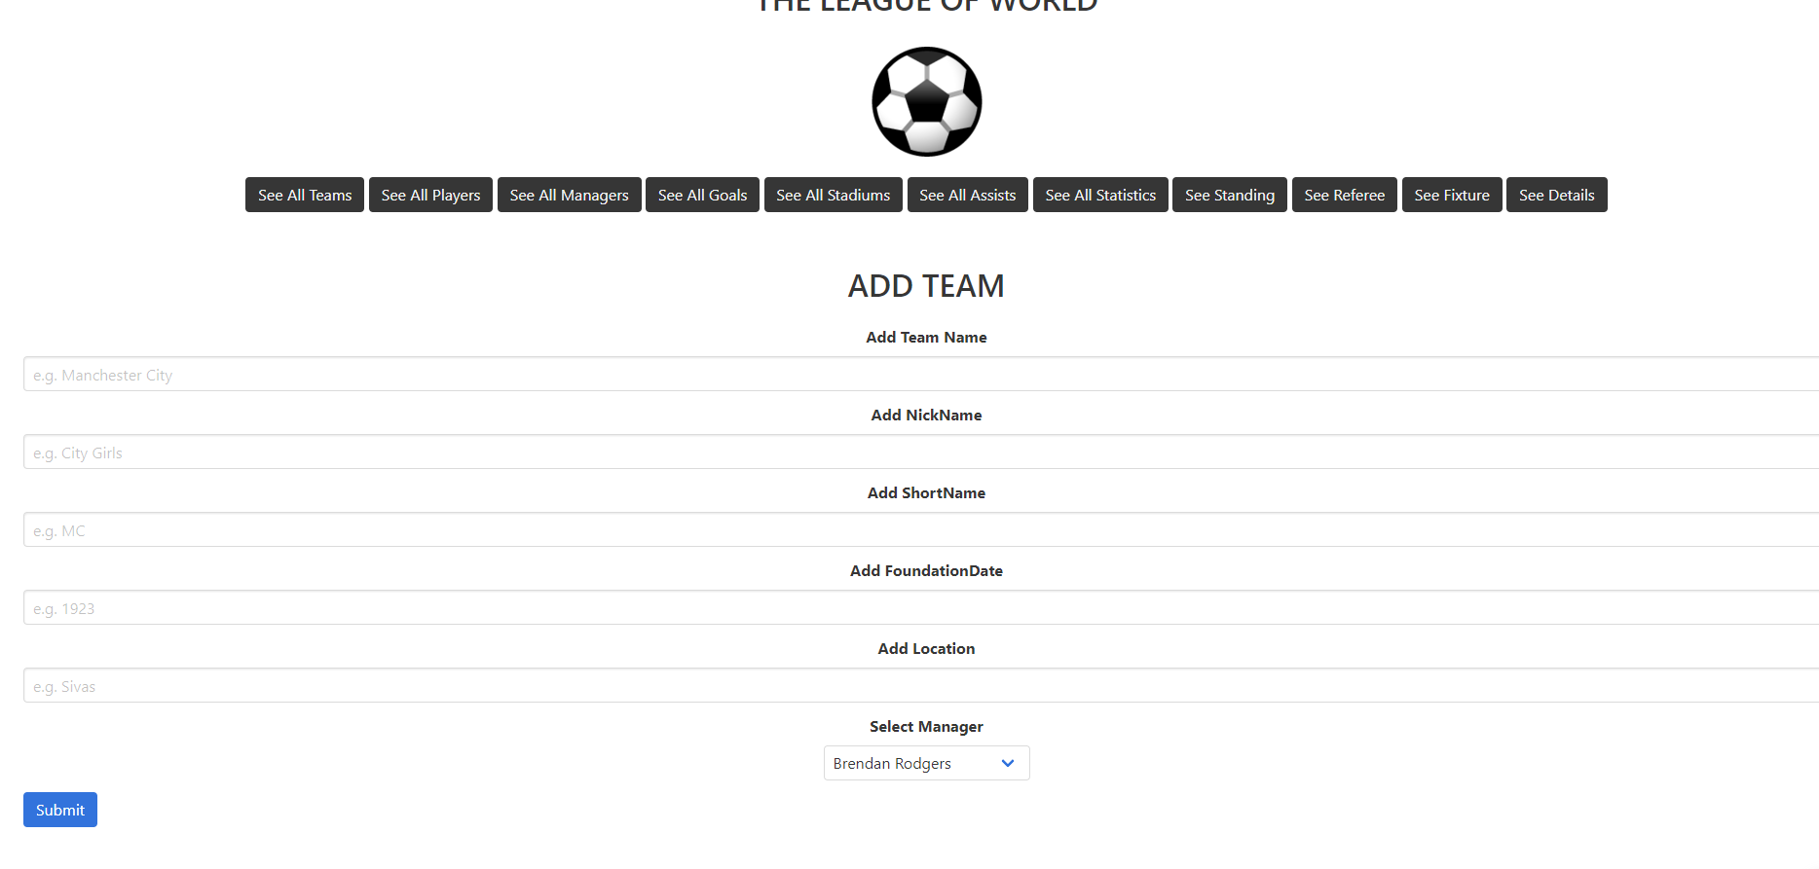
Team addding page for developer.

Slide 51
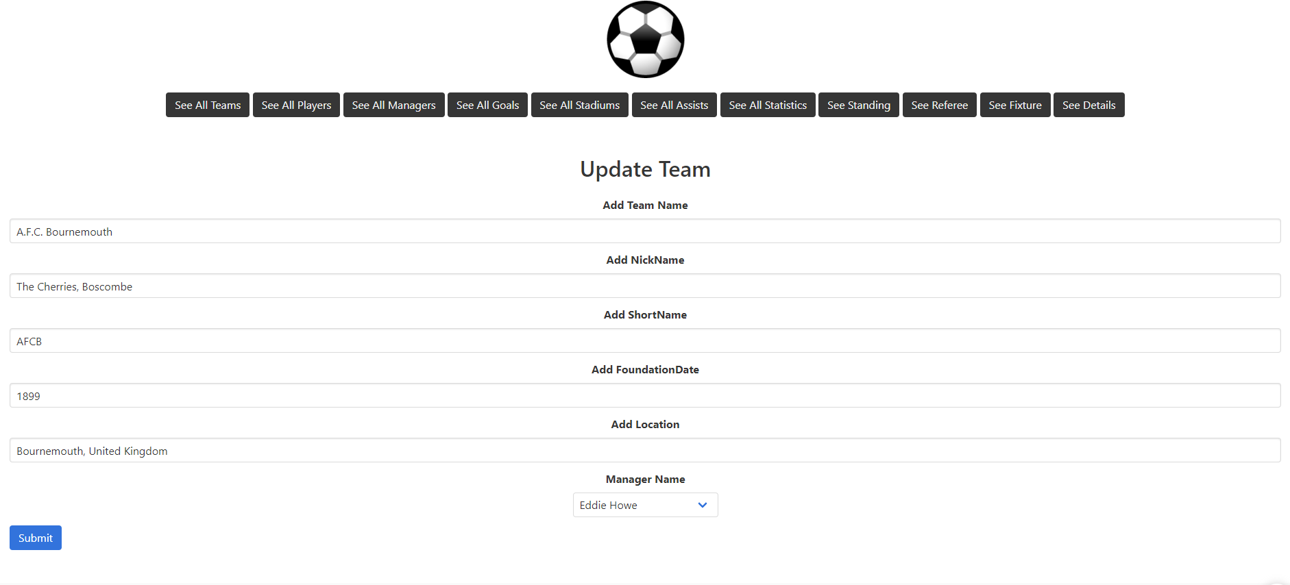
Team update page for developer.

Slide 52
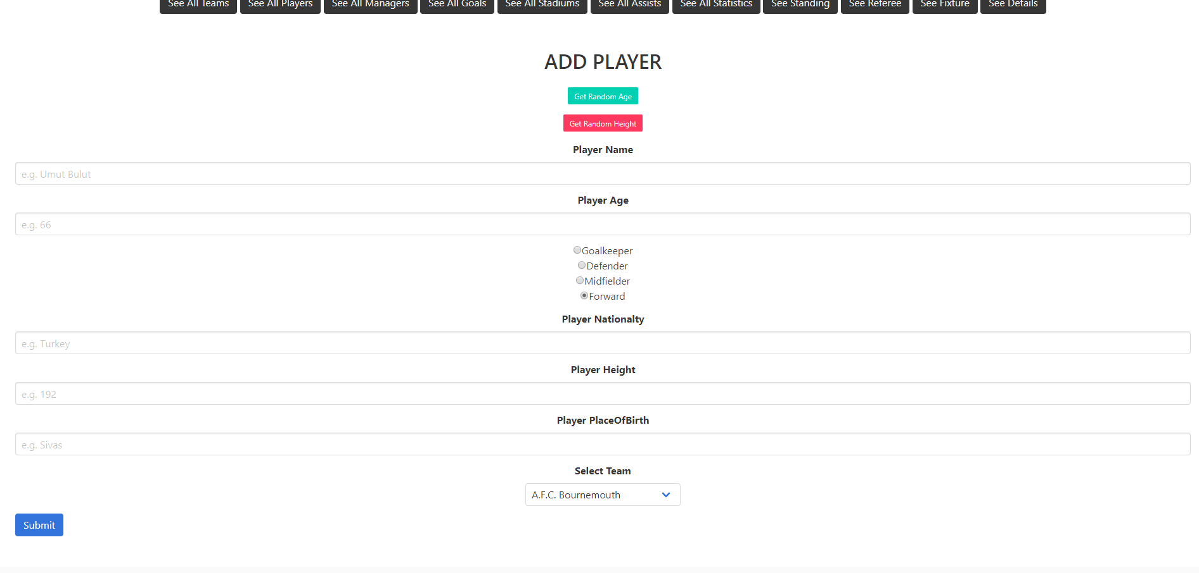
Player addding page for developer.

Slide 53
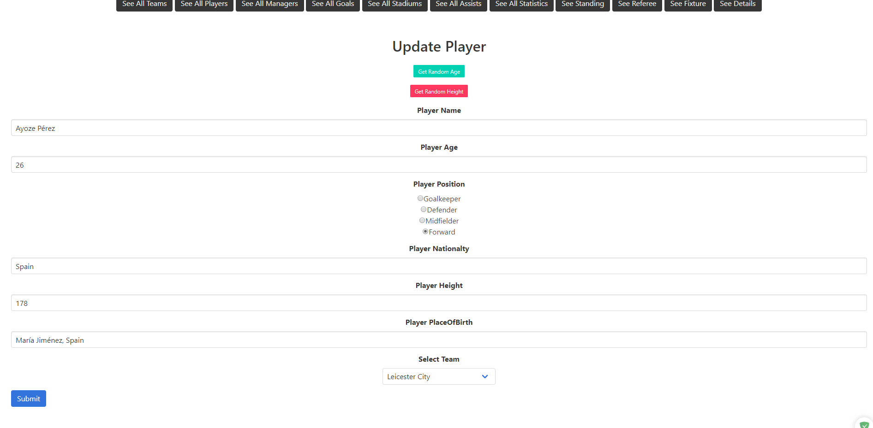
Player update page for developer.

Slide 54

Manager addding page for developer.

Slide 55

Manager update page for developer.

Slide 56

Goal addding page for developer.

Slide 57

Goal update page for developer.

Slide 58

After logging in, the developer can start and control the match by clicking the ‘Live button’ in fixture table.
Developer can add detail, goal, assist and statistic via this page.
Each teams’ players are shown in this page.

